Slide 1
Smart Cities and West Baltimore Summary and Community of Stakeholders Matchmaking Workshop
NSF Smart and Connected Communities 2017 Planning Grant
Hosts
Federal Reserve Bank of Richmond, Baltimore Branch
University of Maryland, College Park
University of Baltimore
Morgan State University
Johns Hopkins University

Slide 2
This work has been supported by
the National Science Foundation
under grant No 1737495

Slide 3
Katherine Klosek
GovEx, Johns Hopkins University
Originally from Baltimore City, Katherine currently serves as Director of Applied Research at the Center for Government Excellence (GovEx) at Johns Hopkins University. In this role, Katherine helps local governments rethink the ways they have traditionally worked, and translate policy recommendations and promising practices into action. Katherine began her career in Governor O’Malley’s StateStat Office, advancing progress toward statewide economic opportunity and health policy goals as part of the StateStat performance management team. Before joining GovEx, Katherine directed Baltimore City's Partnership to End Childhood Hunger, leading a coalition of public and private actors in planning and implementing evidence-based strategies to eradicate hunger and improve family stability.

Slide 4
Poll Everywhere – Live Digital Polling
Option One
Use your smartphone browser
Go to pollev.com/nickfinio286
Enter your name (anonymous is fine!)
Follow on-screen instructions
Option Two
Use your phone’s text messaging
Create a text to the number 22333
Put “NICKFINIO286” (without the quotes) in the text body
Send the text and await a response, follow instructions in the response

Slide 5
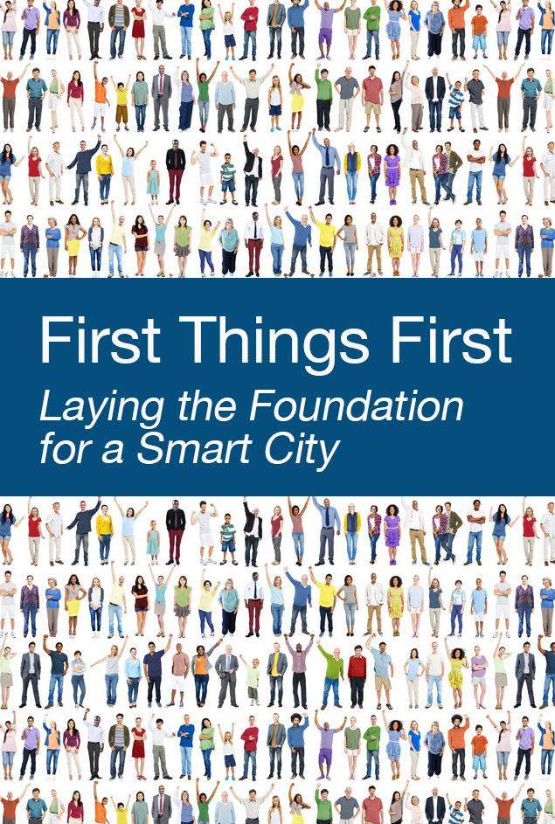
Notes:
https://docs.google.com/document/d/1LGdeSKCZcwb9sjxzCylkc2-Ehmf7tdT-bouFxFljoHc/edit#

Slide 6
Interviewees
Colorado Springs, CO
Columbus, OH
Kansas City, MO
Louisville, KY
Portland, OR

Slide 7
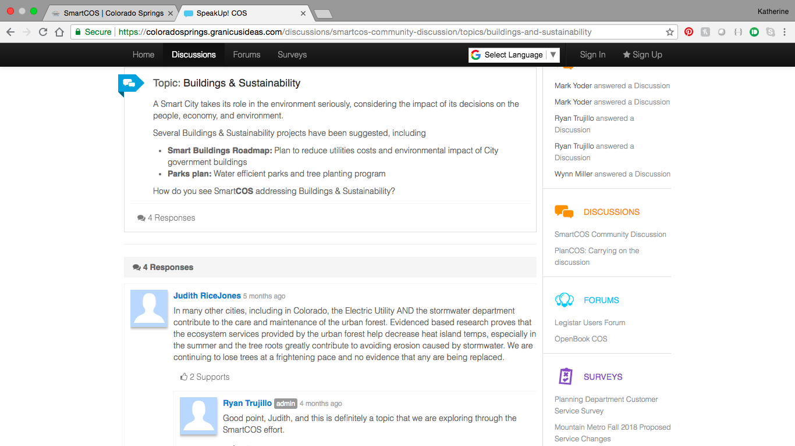

Slide 8
Smart Columbus
Winner of 2016 U.S. Department of Transportation
Smart Cities Challenge
One project will focus on prenatal trip assistance
to address the City’s infant mortality goals
Notes:
https://www.columbus.gov/smartcolumbus/home/

Slide 9
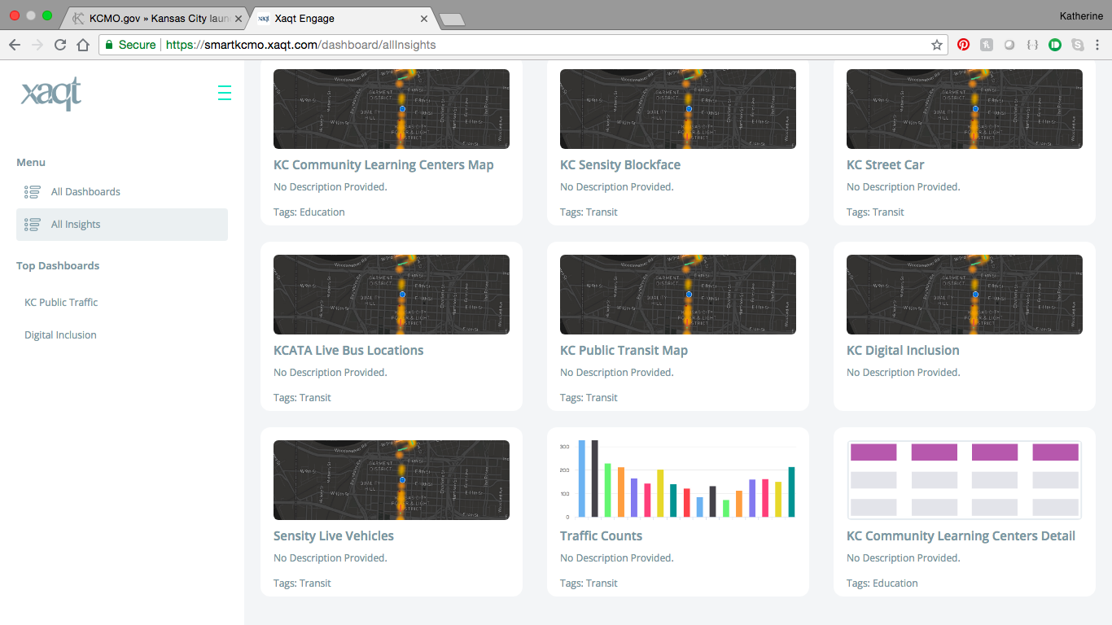
Notes:
https://smartkcmo.xaqt.com/dashboard/allInsights

Slide 10
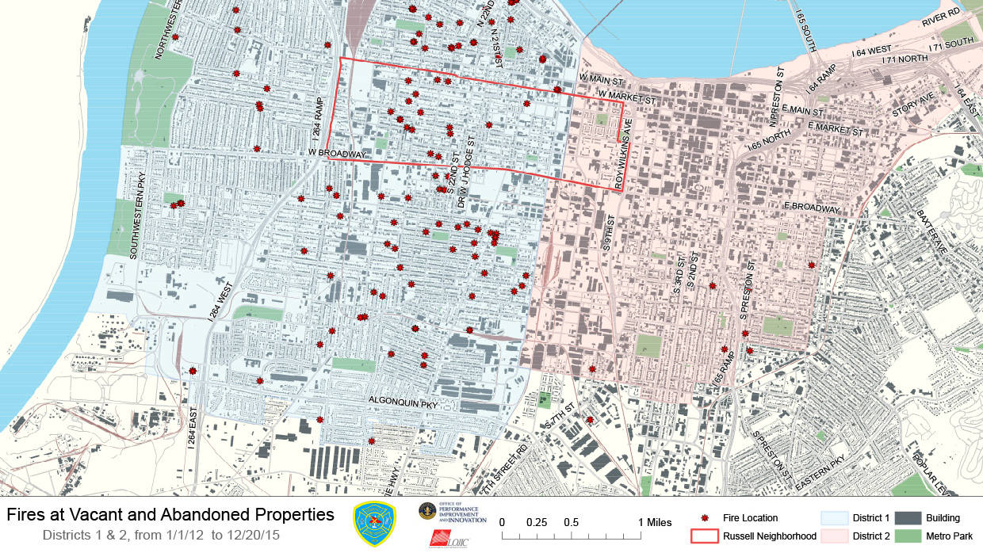
Smart Louisville
Notes:
https://louisvilleky.gov/government/smart-louisville

Slide 11
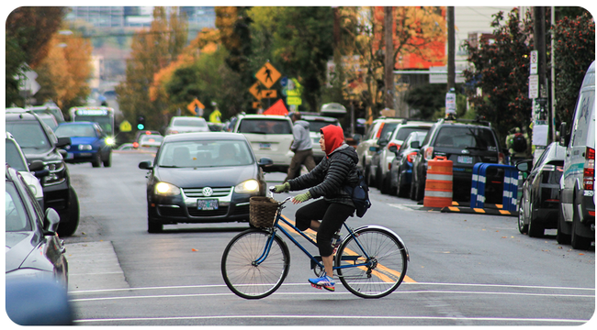
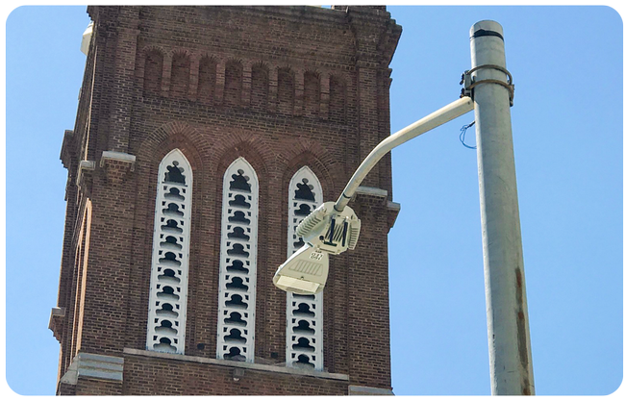

Slide 12
Highlights and promising practices
Smart cities initiatives should be driven by city goals
Not solutions looking for a problem
Residents should be involved from the beginning, and cities should communicate updates and results of a smart cities initiative to residents in multiple ways
Communication should continue throughout the smart cities project/process
Smart cities plans should be integrated with existing data governance committees and practices to preemptively address concerns
Smart cities data structures are not different from administrative data
Cities should work with vendors and other partners to address issues of data ownership, sharing, and security and privacy
Include outcomes in vendor contracts where possible/appropriate

