Slide 1
Smart Cities and West Baltimore Summary and Community of Stakeholders Matchmaking Workshop
NSF Smart and Connected Communities 2017 Planning Grant
Hosts
Federal Reserve Bank of Richmond, Baltimore Branch
University of Maryland, College Park
University of Baltimore
Morgan State University
Johns Hopkins University

Slide 2
This work has been supported by
the National Science Foundation
under grant No 1737495

Slide 3
Seema Iyer
Associate Director, Jacob France Institute, University of Baltimore
Seema D. Iyer, PhD is Associate Director of the Jacob France Institute at the University of Baltimore. She oversees the Baltimore Neighborhood Indicators Alliance at JFI (BNIA-JFI) which collects, integrates and disseminates community-based quality of life indicators. BNIA-JFI annually produces the City's Vital Signs report that "takes the pulse" of what's going on in Baltimore's neighborhoods. Seema is currently serving on the Executive Committee of the Urban Institute's National Neighborhood Indicators Partnership (NNIP), a network of city-partners including BNIA-JFI that provide longitudinal, community based data for neighborhood planning and advocacy.
Her research focuses on the role of data sharing in collaborative public innovation processes. Seema is also Program Director of the Real Estate and Economic Development (REED) program in the Merrick School of Business at UB. Prior to joining UB, she was chief of research and strategic planning for the Baltimore City Department of Planning from 2005-2011. In 2017, she was a Fulbright-Nehru Scholar in Bangalore, India, researching the role of urban governance for metropolitan economic competitiveness. Her blog from the experience is available at blogs.ubalt.edu/siyer. Seema holds a Ph.D. in urban and regional planning from the
University of Michigan, Ann Arbor.

Slide 4
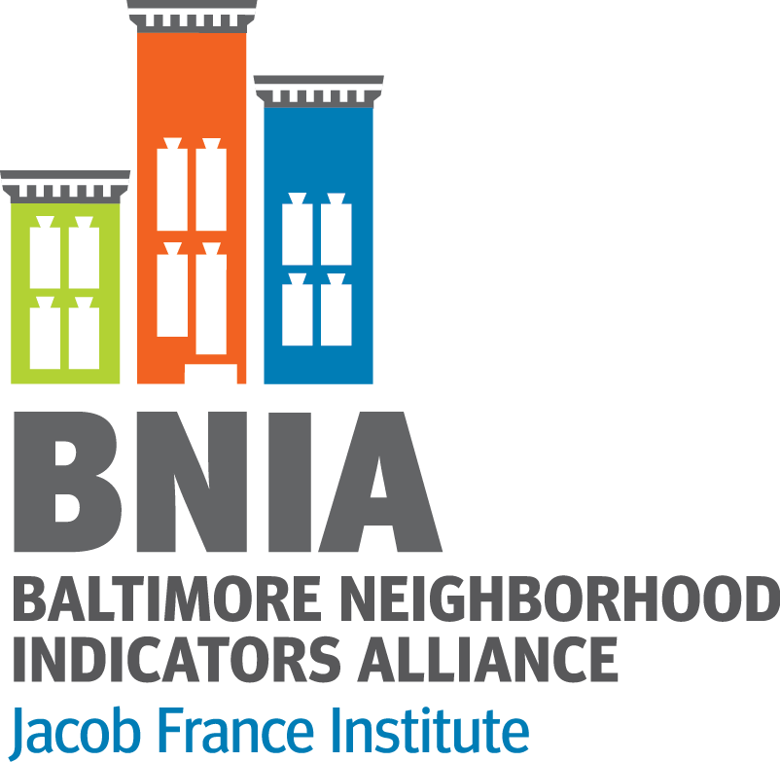
Supporting Data-Driven Decision Making in West Baltimore for Smart Technology Planning
NSF Smart and Connected Communities July 12, 2018
Seema D. Iyer, PhD
@bniajfi

Slide 5
About Baltimore Neighborhood Indicators Alliance
Began nearly 20 years ago by local stakeholders, now based within Jacob France Institute at University of Baltimore
Part of the National Neighborhood Indicators Partnership
“One-stop-shop” for comprehensive, administrative data and training
Multiple topic areas (demographics, housing, crime, education, etc.)
Data over time (2000 – 2018)
Vital Signs – annual report of quality of life indicators for Baltimore’s communities

Slide 6
Indicators as a Proxy for Community Issues
Safety
Crime Rate
Blight
Vacant and Abandoned Housing
Health
Life Expectancy
Concept
Indicator

Slide 7
Data Engagement Protocol
Data sharing as a knowledge management strategy can help establish common understandings among potential collaborators*
Collaborative innovation among multi-sector actors is a process that moves from interaction to collaboration to innovation
Data that measures effectiveness of city services and improvement in quality of life can promote citizen participation by demonstrating how use of data can establish a democratic space for engagement
*Iyer, Seema D. (2015) “Barriers to Data Sharing for Inclusive Knowledge Management” in Innovations in the Public and
Nonprofit Sectors: A Public Solutions Handbook, Patria de Lancer Julnes & Ed Gibson, eds., M.E. Sharpe Press. Pp. 91-109.

Slide 8
West Baltimore Community Meetings
Overarching Question:
How can “smart technology” help improve the quality of life in West Baltimore?
BNIA Objectives:
Understand how neighborhoods use data about the area
What are the neighborhood’s concerns and issues based on existing information
What kinds of information gaps exist
How would data be accessed in the future?

Slide 9
Community Outreach Meetings
Two communities:
Heritage Crossing
State Center Neighborhood Alliance
Community Trainings:
Meeting #1- Presentations around available data; breakout discussions with residents
Meeting #2- Hands-on computer workshops for accessing data

Slide 10
Community Outreach Meeting #1
BNIA convened initial trainings with Heritage Crossing and State Center in April 2018
First meeting focused on community data from Vital Signs and Baltimore City Planning
Breakout Group Questions:
What would you like to improve in the neighborhood?
What additional data would you like to see?

Slide 11
Meeting #1 – Heritage Crossing
Attendance: 7 residents
Resident-Led Discussion Topics:
How to increase population and income
Homeownership information
Local economy and employment
Neighborhood spending power
Communication tools to engage with residents?
Population under community supervision

Slide 12
Meeting #1 – State Center
Attendance: 18 residents
Resident-Led Discussion Topics:
Baltimore City Open Data
Frequency of updates
Sharing of new datasets
Data quality
Employment and commute destinations
Trash and sanitation
Disease prevalence

Slide 13
Community Outreach Meeting #2
Agenda derived from discussion topics from the first meeting
Trainings held at University of Baltimore in June 2018
Hour and half workshops using computer lab to access online resources

Slide 14
Meeting #2 – Heritage Crossing
Attendance: 5 residents
Workshop topics:
1. Accessing Vital Signs data
Finding community profiles and data visualizations
2. Using Open Baltimore
Keyword searches, building filters, exporting and visualizing data
3. Real Property Lookup
Property searches by address

Slide 15
Meeting #2 – State Center
Attendance: 5 residents
Workshop topics:
1. Accessing Vital Signs data
Finding community profiles and data visualizations
2. Using Open Baltimore
Keyword searches, building filters, exporting and visualizing data
3. LEHD OnTheMap
Custom report for employment characteristics

Slide 16
Community Concerns
How can resources be used to leverage funding/grants?
How to find information across different sources?
How can we best visualize data for action/strategizing?
How can we use data to brainstorm and learn?
What is the quality of the data?

Slide 17
What is a Data-Driven Smart City?
Smart Economy—entrepreneurship, innovation, new forms of economic development such as sharing economy and open data economy
Smart Government—e-government, evidence-informed decision making, transparency, participatory
Smart Mobility—interoperable/multi-modal transport systems, sharing services
Smart Environments—sustainability, resilience, renewable energy
Smart Living—improving quality of life, increasing safety, reducing risk
Smart People—informed citizenry, fostering creativity, inclusivity, empowerment
Rob Kitchin (2018) “Data-Driven Urbanism” in Data and the City, Routledge, New York, NY

Slide 18
Data Subjects
Data Citizens

Slide 19
Next Steps
“Crowdsource Data Tool Collective for Baltimore” event at Baltimore Data Day on July 13
Create a resource for everyone to view and keep track of new and existing applications using open data to improve the quality of life in Baltimore.
Results of this event will be a crowdsourced, open compilation of existing tools that can be used by communities and enhanced by civic technologists and others at future events.

Slide 20
http://www.bniajfi.org
Resource Page: https://bniajfi.org/currentprojects/smartcitiesresources
bnia-jfi@ubalt.edu
@bniajfi Twitter/Facebook

