Slide 1
Smart Cities and West Baltimore Summary and Community of Stakeholders Matchmaking Workshop
NSF Smart and Connected Communities 2017 Planning Grant
Hosts
Federal Reserve Bank of Richmond, Baltimore Branch
University of Maryland, College Park
University of Baltimore
Morgan State University
Johns Hopkins University

Slide 2

This work has been supported by
the National Science Foundation
under grant No 1737495

Slide 3
Sheri Parks
Vice President for Strategic Initiatives, Maryland Institute College of Art
Dr. Sheri Parks came to MICA from the University of Maryland, College Park (UMCP), where she was the inaugural Associate Dean for Research, Interdisciplinary Scholarship, and Programming for the College of Arts and Humanities. Through her position, she helped raise the profile of the college in the nation, as well as its levels of sponsored research, community engagement and interdisciplinarity.
At UMCP, Parks taught in American Studies. Until recently, she was the Founding Director of the Arts and Humanities Center for Synergy, which fosters interdisciplinary and socially engaged research and activity. An active and leading presence in Baltimore, she currently serves as the president of the board of directors for the Greater Baltimore Cultural Alliance.

Slide 4
Smart Cities and
Deep Community Engagement
Partnered with community organizations and leaders. Made use of ongoing relationships.
We have engaged the community in two rounds of conversations.
Deep community conversations: 7 sessions
Return for co-planning sessions, including reactions to city innovations, with graphic artist.

Slide 5
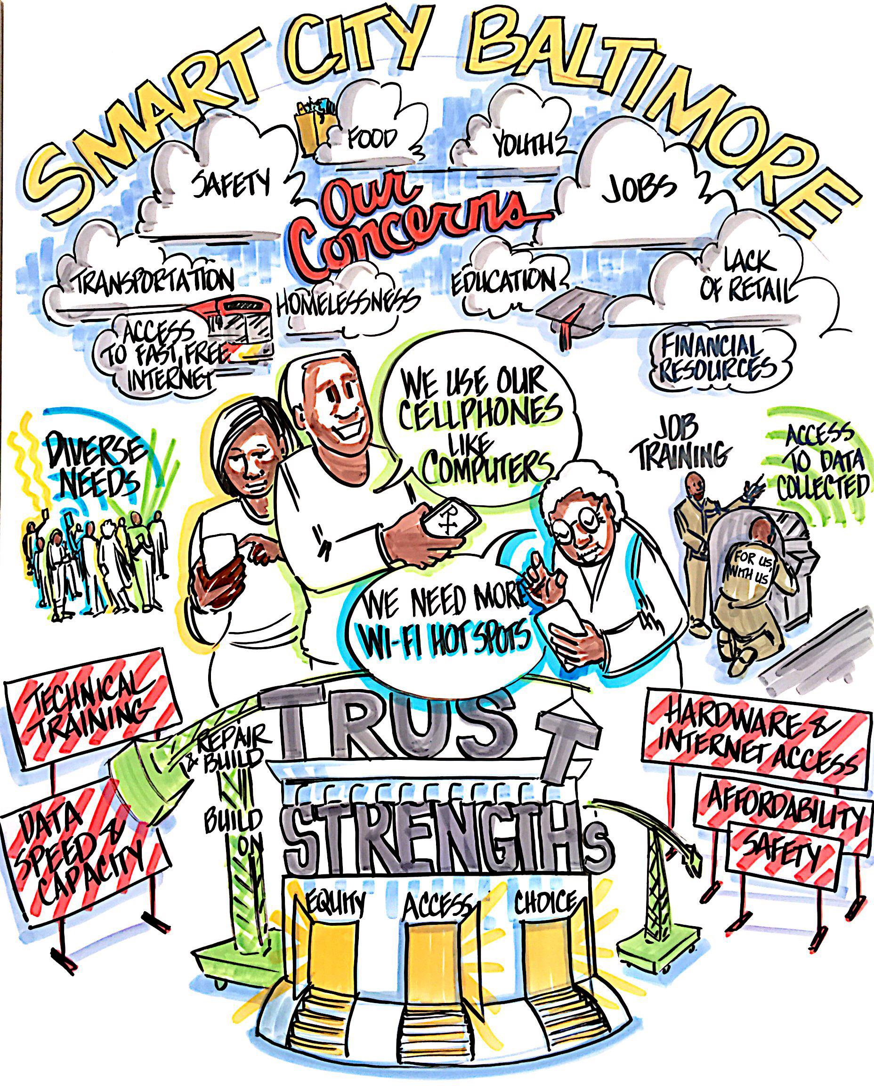

Slide 6
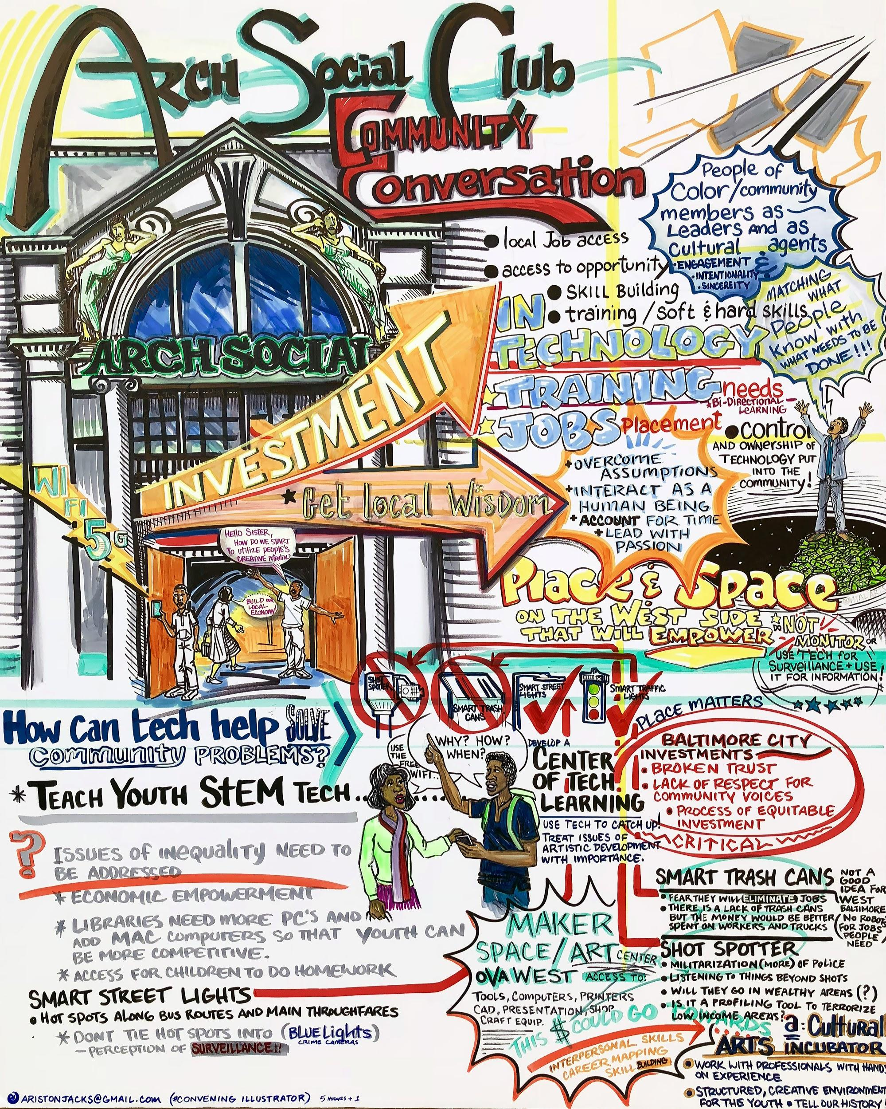

Slide 7
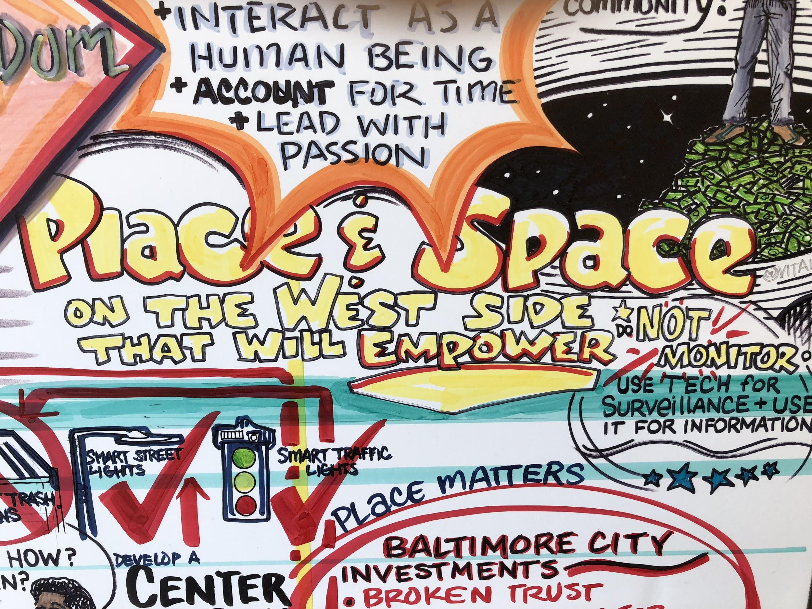

Slide 8
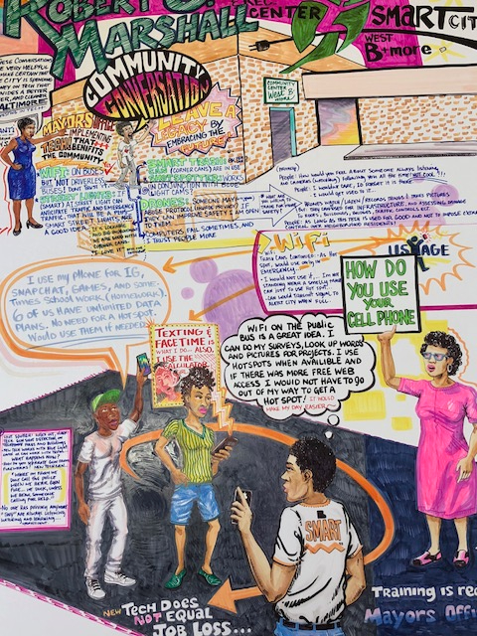

Slide 9
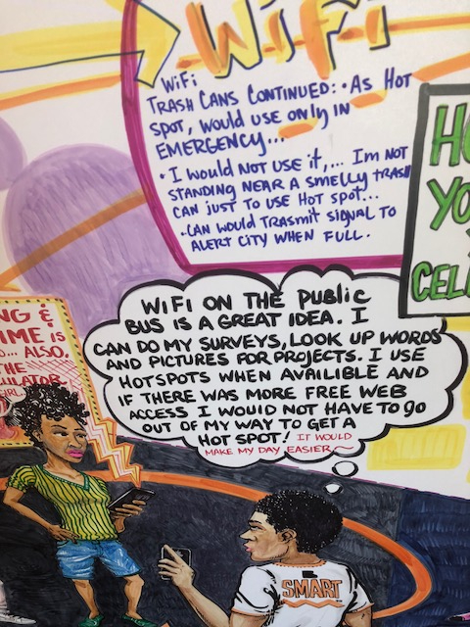

Slide 10
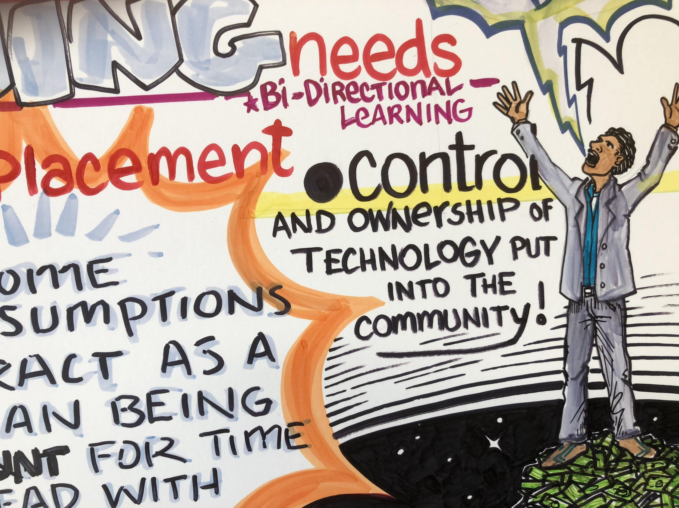

Slide 11
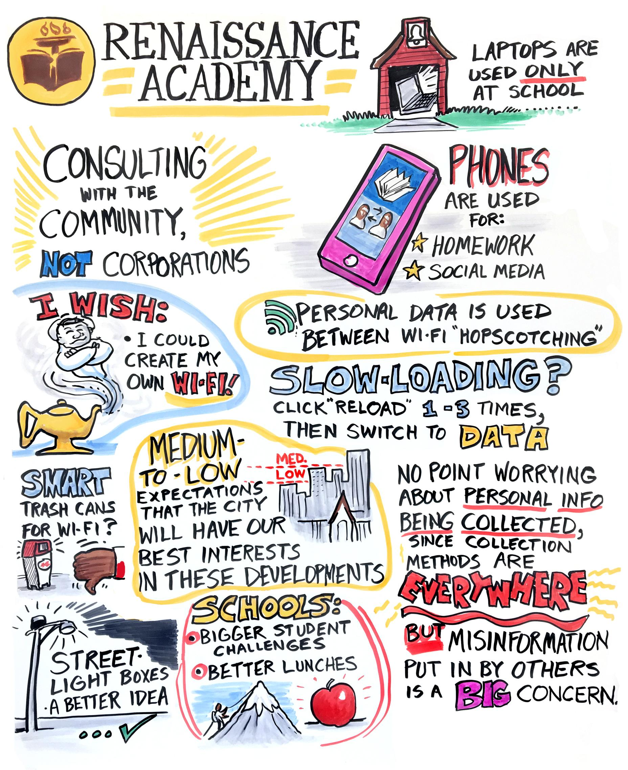

Slide 12
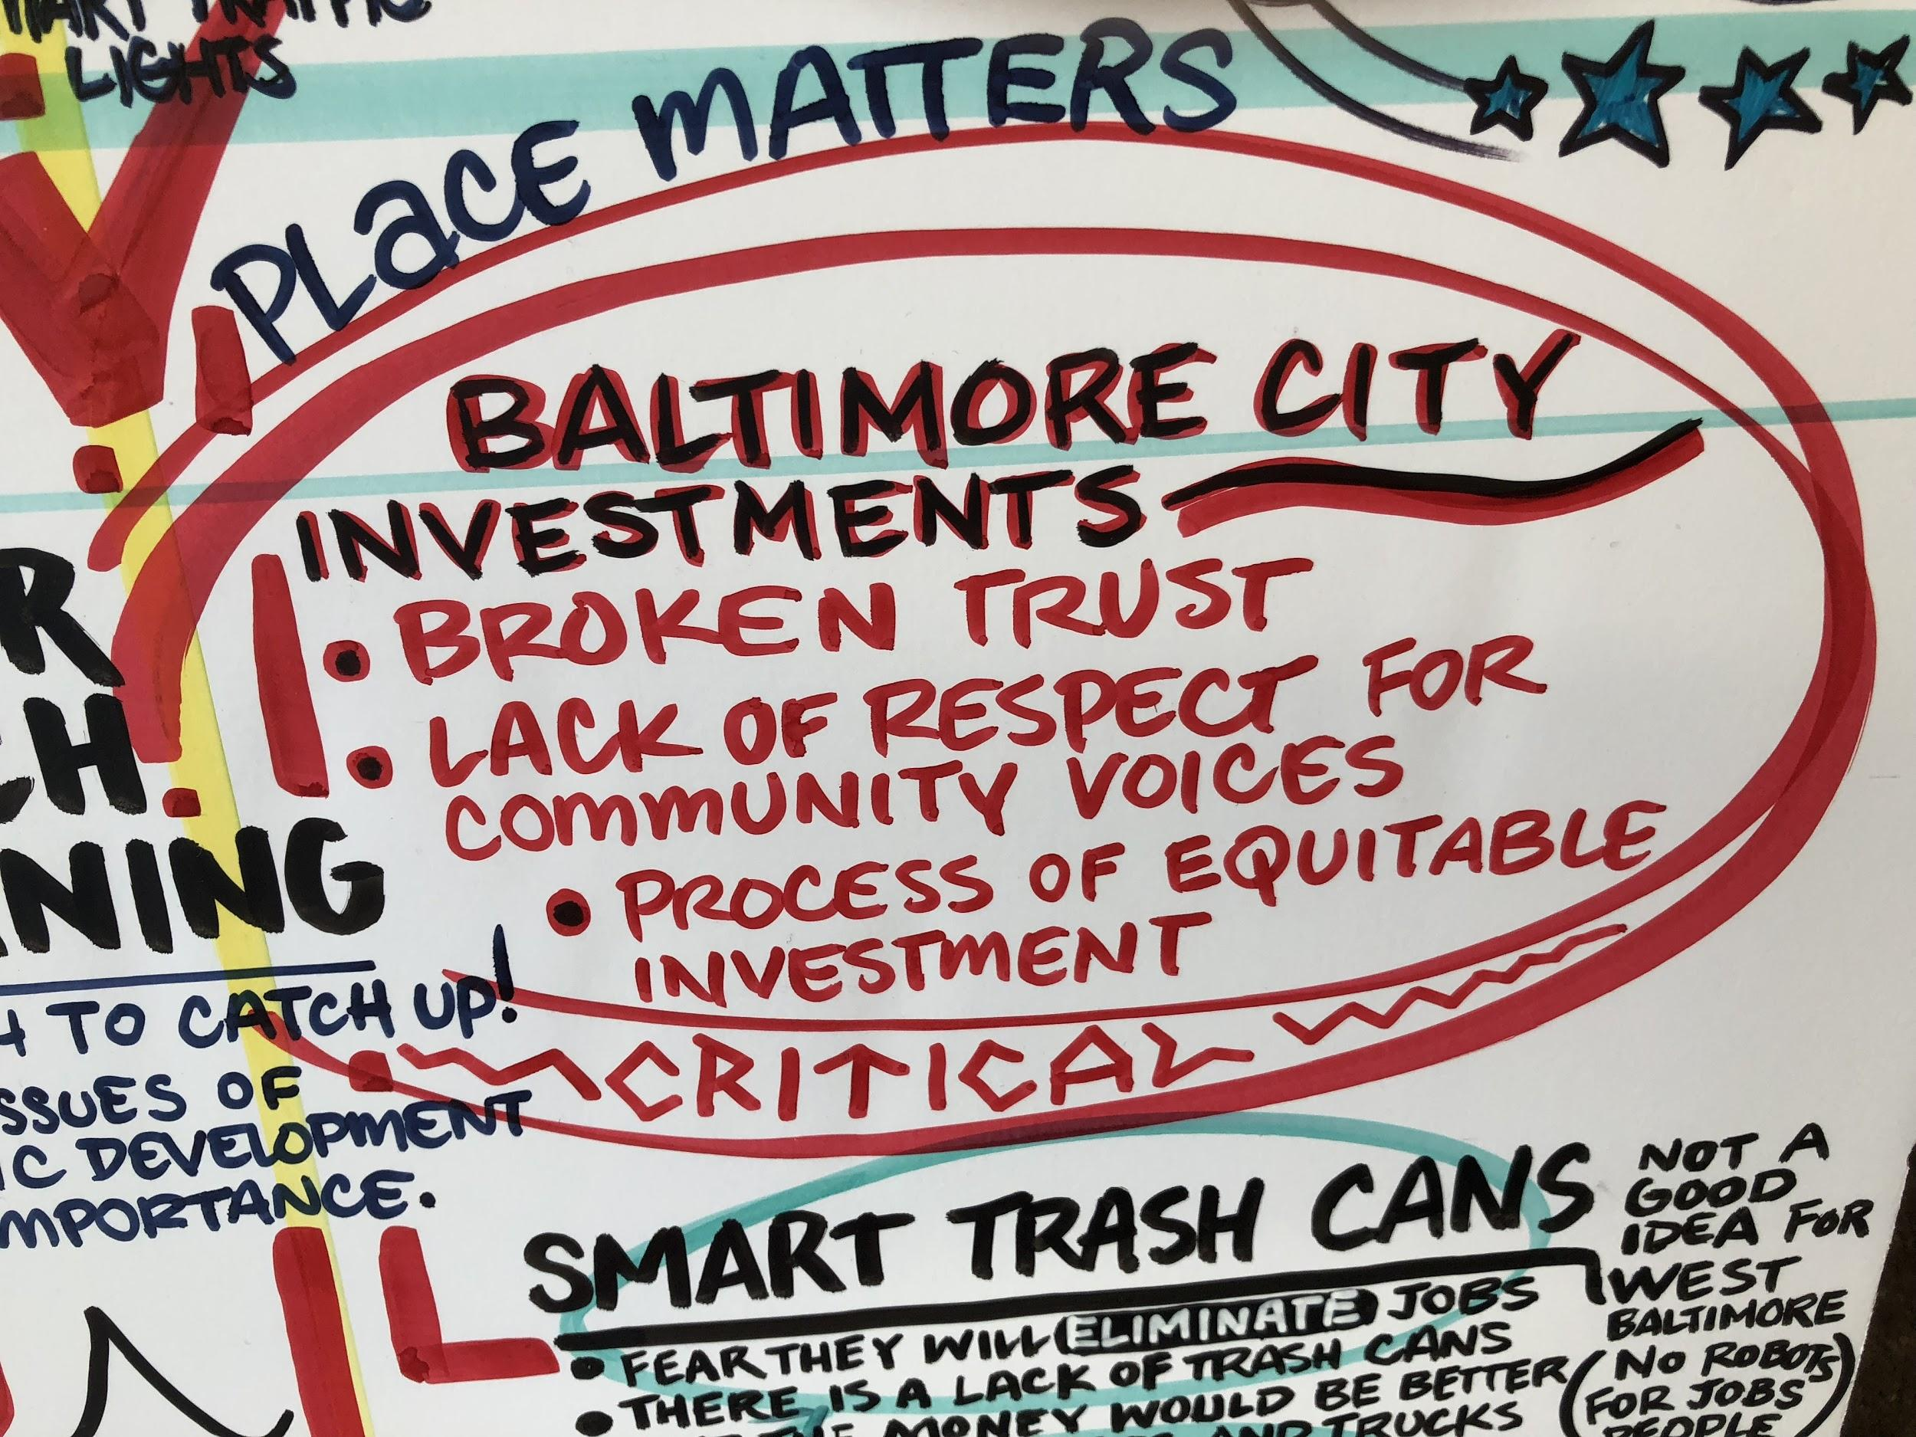

Slide 13
Findings
Equity: Acutely aware of technological advances that other communities have
Resilient: Sophisticated use of the technology they do have
Gift economy: Sharing and mapping of free wi-fi
Public/Private: No street corner activity.
Concerns: Quality of food, jobs and transportation

Slide 14
Suggestions
Access rather than new technology
Work spaces
Maintenance/programming jobs to provide sustainability
Consistent with services in nearby affluent neighborhoods
Cost and bill effective
Balance human and technology roles

Slide 15
Sheri Parks
Vice President for Strategic Initiatives
Maryland Institute College of Art (MICA)
sparks01@mica.edu

