Slide 1
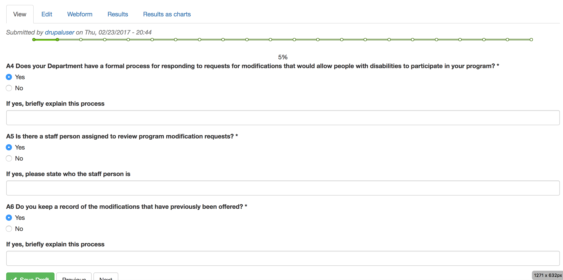
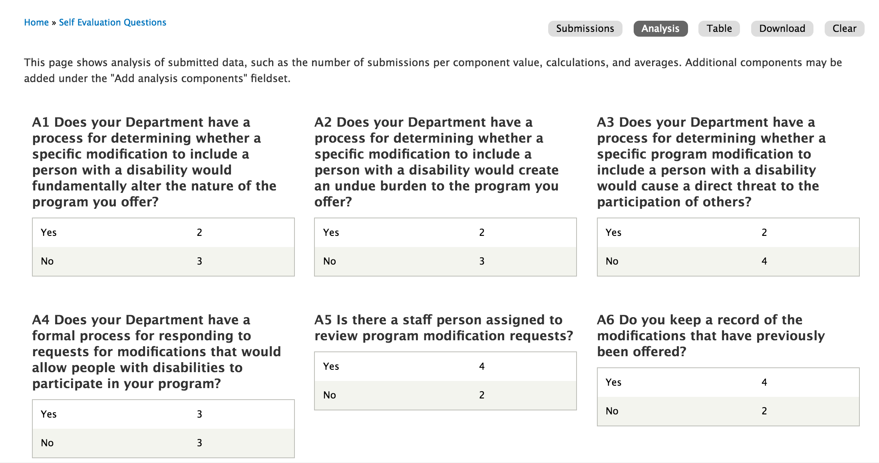
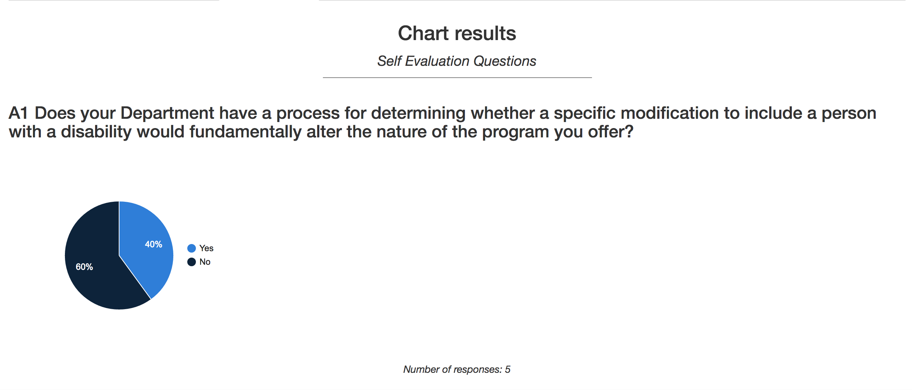
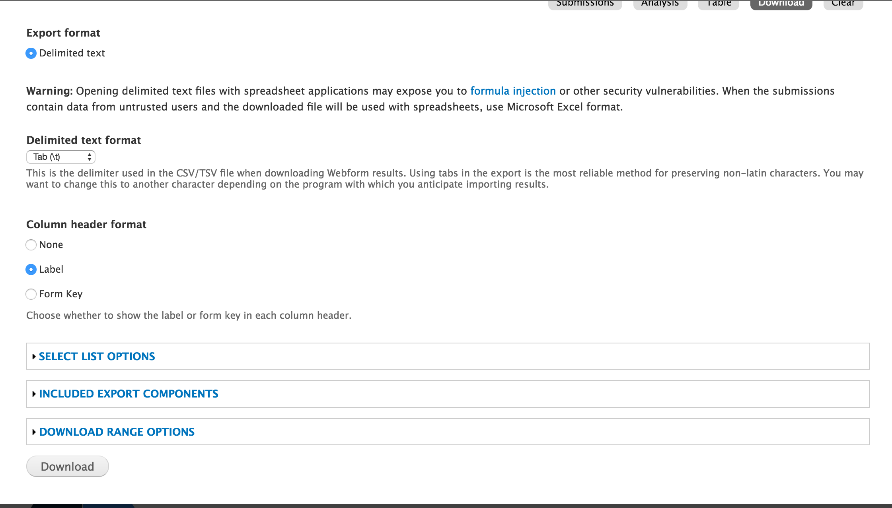
ADA Online Survey Tool
Developer: Hitesh Gupta | Professor: Dr. Kathy Weaver | Client: Anne Arundel County: Joelle Ridgeway
Objective
Screenshots
Challenges
The project involves:
Developing an online survey tool for the Department of Aging and Disabilities, Anne Arundel County.
The purpose of this project is to develop a web enabled database that will help to track ADA Accessibility issues throughout Anne Arundel County Government
The Department of Aging and Disabilities would like to ensure accessibility of all county programs, service, activities, and facilities to citizens with disabilities.
Objective:
Develop a web based survey tool
Test the tool internally and then extend it to other departments
Analyze and Visualize data.
Working on the VCL environment:
Website being hosted on VCL machines, which turns off after 4 hours of inactivity
Virtual IP
Requires sending the IP Address to client on a daily basis.
Designing Visualizations:
No experience in designing and creating dashboards.
Was able to overcome this challenge by learning D3.js and Drupal visualization modules.
Using Unix commands to access Drupal files on the server:
No familiarity with UNIX commands and servers
Methodology
Successes
Requirement Gathering & Analysis
Design
Development & Testing
Documentation
Selection of Development framework
Used Drupal
Clients were really impressed with the ease of manipulation of content.
Streamlined Process for the client
Clients were impressed with the reports and Visualizations designed.
Improved Requirements Gathering skills
Technologies Used
Final Deliverables
Fully Functional Web Application for capturing responses, analyze and visualize them.
Comprehensive Report consisting of User Manual

