Slide 1

Sustainability and Design:
An Investigation of Problems and Solutions in Composting Behavior
Prepared by: Brandt Anzalone, Patrick Bevan, Clyde Boyer, Elliott Brody, Julius Cochran, Yared Demissie, Jonathan Gorczyca, Benjamin Grove, Chaya Johnson, Ingride Ngaku, Bianca Reginauld, Corey Sackalosky, Jason Schneider, Charis Smith, Samuel Soon, Caroline Swetonic, Christopher Tang
Under the supervision of Nicole Mogul
Course #: CPSP249E
The University of Maryland – College Park
Spring 2018
PALS - Partnership for Action Learning in Sustainability
An initiative of the National Center for Smart Growth
Gerrit Knaap, NCSG Executive Director
Uri Avin, PALS Director

Slide 2
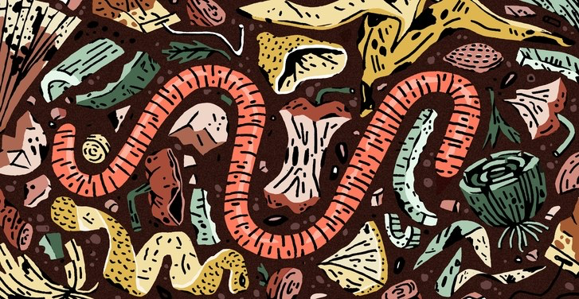
Final Presentation
CPSP249E
“Sustainability & Design”

Slide 3
The Problem
People aren’t composting
  There are many reasons why
Solution
  Find out why and how
  Find what others value
  Develop four design projects that emphasize building different skills

Slide 4

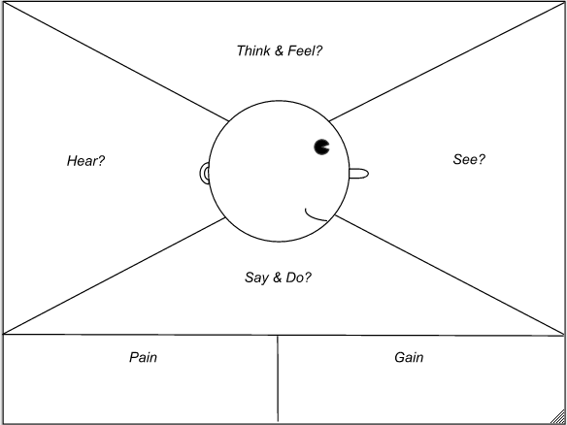
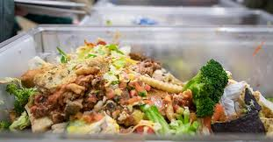
Design Project 1
Interviews: Probe for habits and feelings related to food waste
Food Waste Audit: Observe people and their actual practices
Empathy Map: Organize interview and audit data

Slide 5
Design Project 1 Takeaways
Develop skills for interviewing
  Interact with as many people as possible to aggregate their perspectives
  What is important to users is more important than what is important to the designer
Learn to categorize information (empathy map)
Learn in-depth composting experience

Slide 6
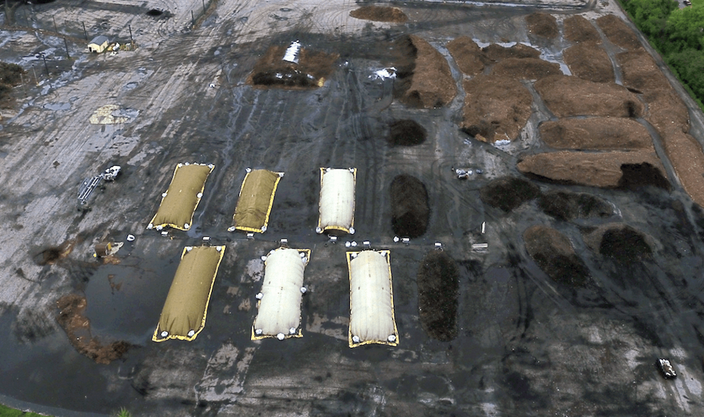
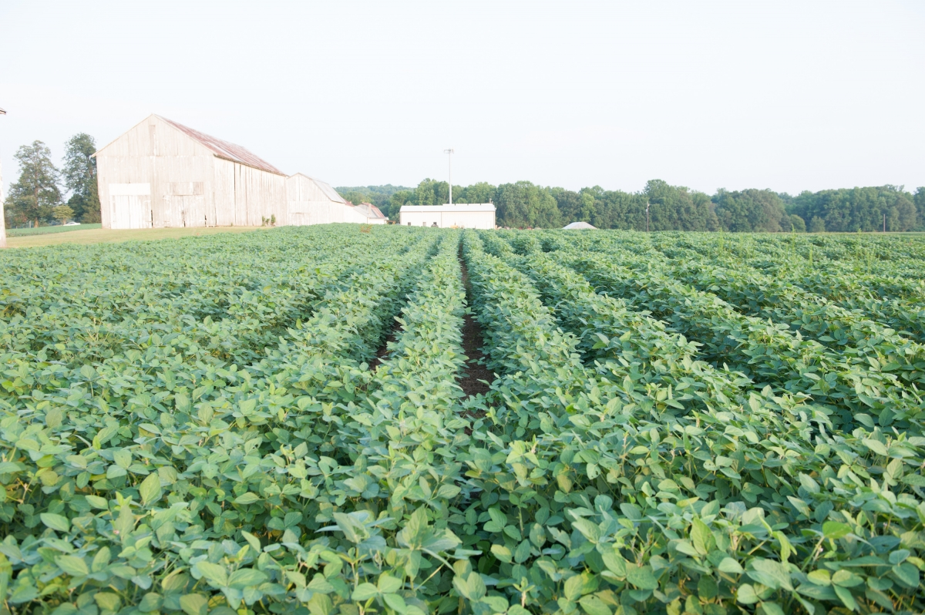
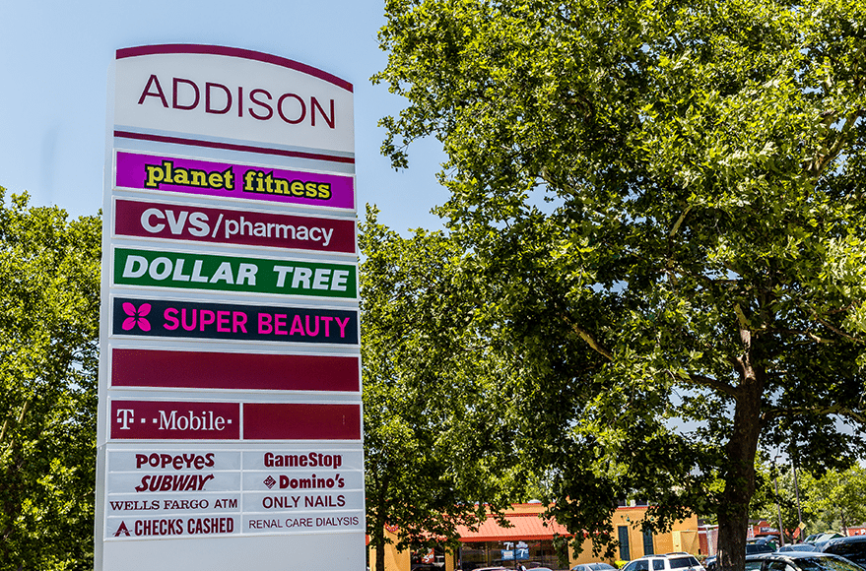
Design Project 2: Site Visits
Western Branch Composting Facility
Terp Farm
Capitol Heights Neighborhood

Slide 7

Design Project 2 Takeaways
Connect to community and stakeholder groups in the design process
Apply principles of “reflexive engineering”
Use a business model canvas for the composting pilot program to get a
product-market fit

Slide 8
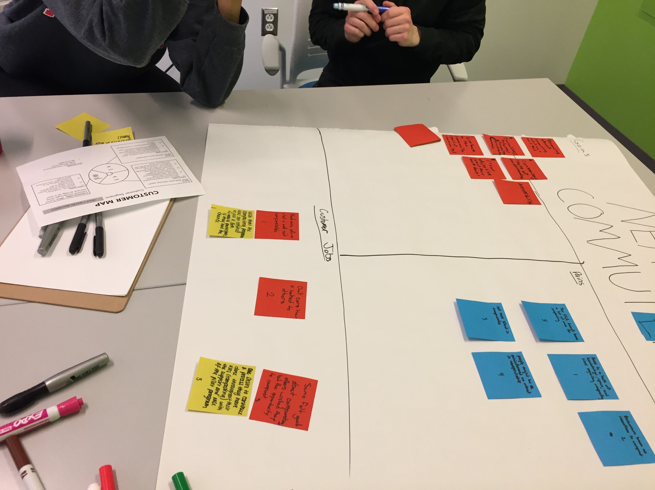
Design Project 3
Design for a particular customer segment to unleash new ideas
Develop prototypes for feedback
  Get something into users hands
  Revise based on user feedback

Slide 9


Design Project 3 Takeaways
Work off a business model
  Select specific groups to consider their wants and needs
  Design specific questions to determine customer values Sormulate designs that meet customer wants/needs
Use advanced brainstorming
  Constraints add perspective
  Develop imaginative ideas
  Unrealistic solutions may be useful
  More firepower in a group
Work in groups more effectively
  Discuss different viewpoints
  Leads to better insights and better designs

Slide 10
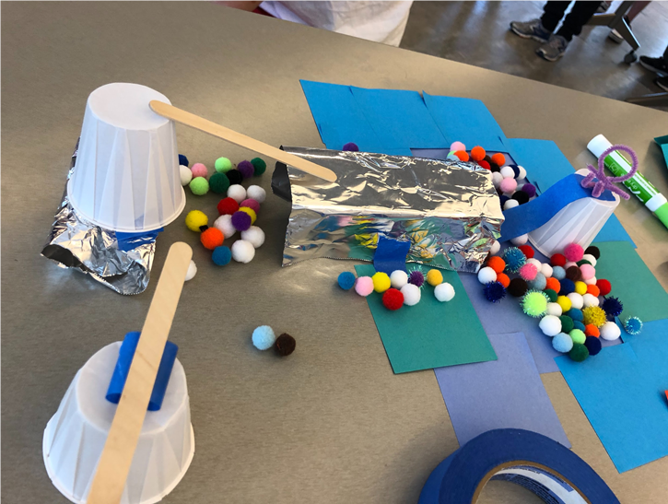
Design Project 4
Use prototypes to collect feedback

Slide 11
Group 1
“Wipeout is a show where people run around on obstacles, and if they fall, they land in water.
Our idea was to have them fall into compost instead, to raise awareness about the issue of food waste in a fun way.
It’s crazy, but could increase awareness.
It didn’t make composting easier or alleviate the problems of middle-class families, our target audience.
I was reluctant to agree to this idea; however, my group was persistent so we ended up going with it.”
A prototype of a version of the game Wipeout where people crash into pits of compost.

Slide 12
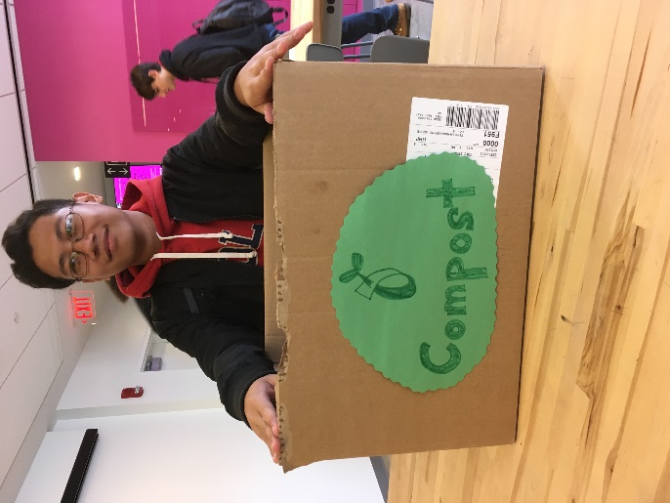
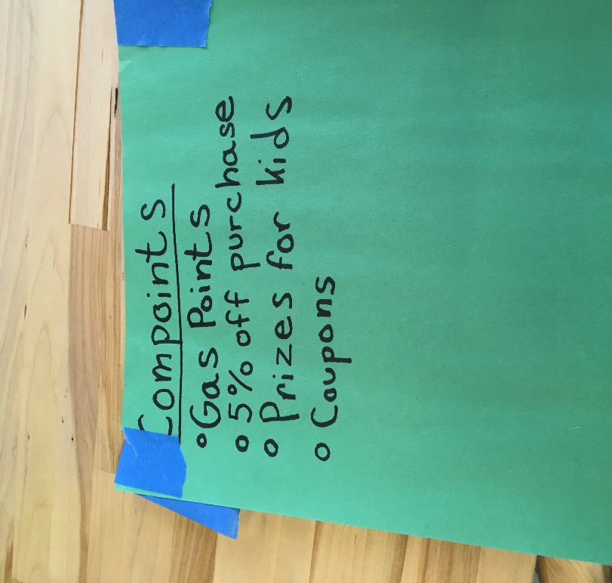
Group 2
“Our prototype was a basic composting box where people could drop off food waste on a grocery trip, earning rewards like gas points or a percentage off their purchase.
We interviewed families with children about the idea and received a lot of positive feedback. Some suggested tiered rewards—the more compost, the more rewards.
I think that our prototype was helpful in generating feedback.
If we had just interviewed without the box, then we probably would have gotten a lot of weird looks and ‘No, thank you’s.’”

Slide 13
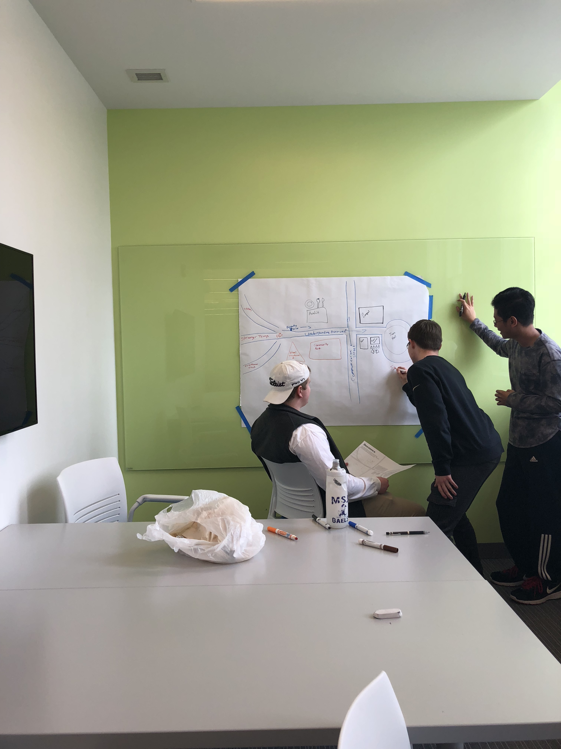
Group 3
“We prototyped a composting magic show with David Blaine escaping from a pile of compost, coupled with environmental science fair projects, including information booths on how to compost.
Our prototype sketched the event on McKeldin Mall, along with an individual sketch of each booth.
Feedback focused on the science fair; that it should focus on environmental projects related to the theme of composting. People also asked how it would work and attract students.
We decided to advertise the science fair in elementary and middle schools to draw in parents who would be the main audience for composting information.”

Slide 14
Takeaways from Design Project 4
Silly doesn’t mean useless
  Unfeasible ideas are useful for starting conversations with people
  Conversations lead to understanding what people think/want/need
Prototypes help generate questions and reactions
Nontraditional presentation methods catch attention

Slide 15
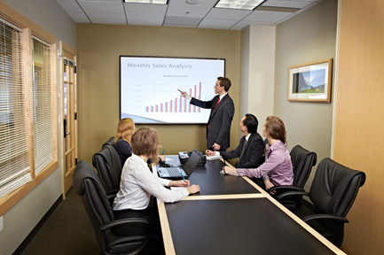
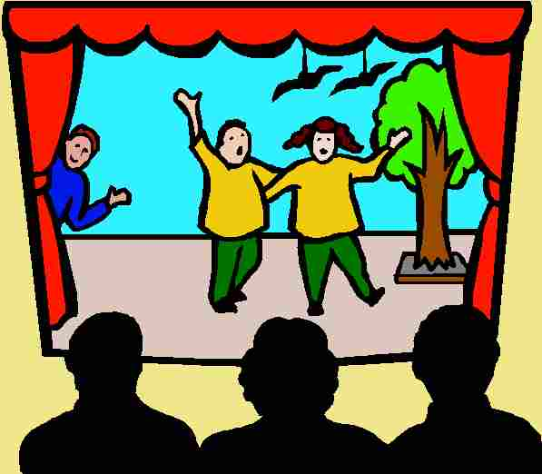
Presentation Methods
Traditional presentations
PowerPoint
Informative Video
Speech
Nontraditional presentations
Creativity can grab attention
Fun or personalized
Tell a story
Try skits, arts and crafts, interactive games

Slide 16
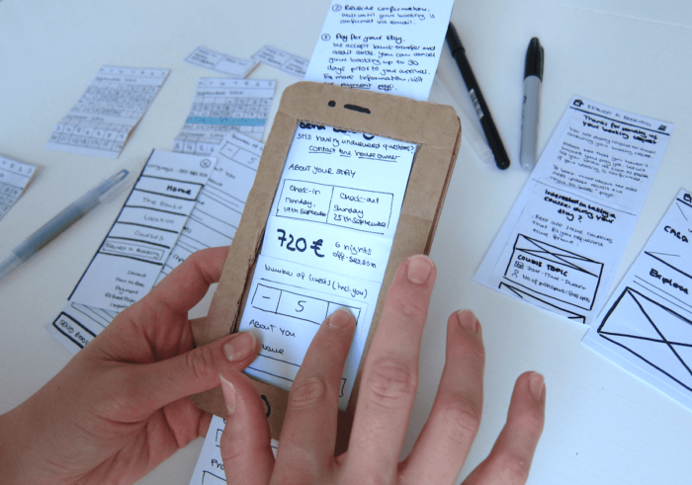
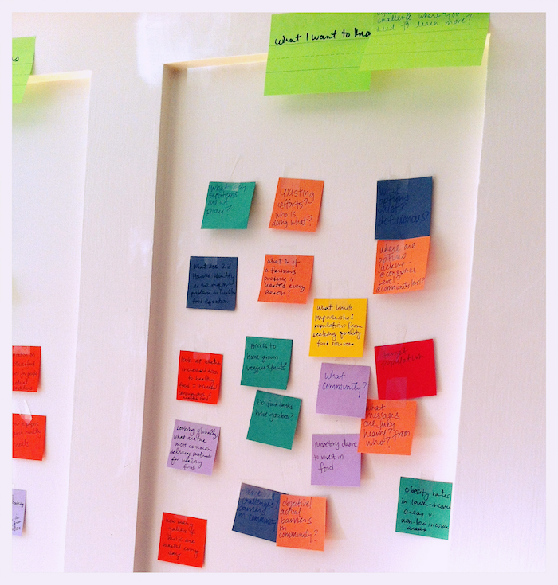
Our favorite part of the design process
Crafting Ideas
  Ridiculous constraints
  As many ideas as possible
Prototyping
  Make the idea real
  See what actually works
Prototypes collect user feedback – they don’t have to look great!
Brainstorm beyond feasible ideas – good ideas are hidden in ridiculous ideas

Slide 17
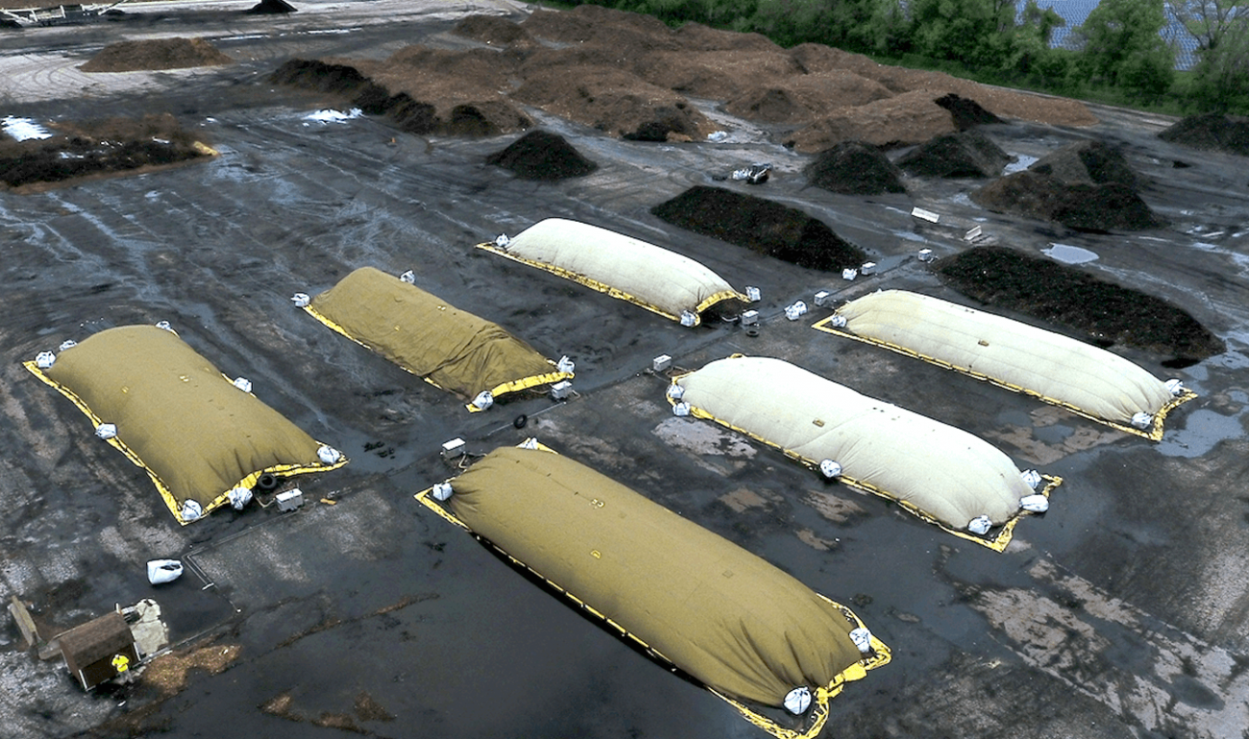
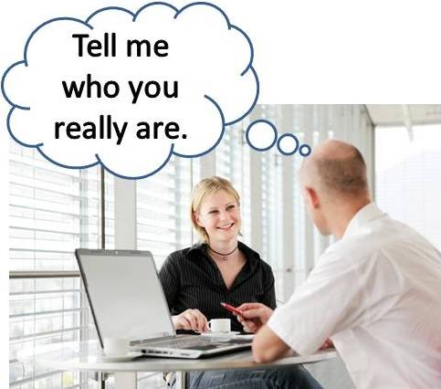
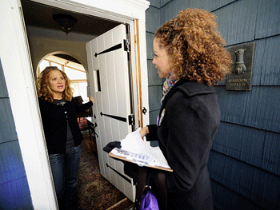
Our favorite part of the projects
Interviews
  Projects were shaped by the interview answers
  Interviews helped in trouble-shooting
Experience-based learning
  See it first hand—it’s relevant!
  Visual and oral learners
  Promotes participation
  It’s FUN
Feedback
  New ideas on how to view and implement projects

