Slide 1
Agronomic Turfgrass Management Plan Harford County
Institute of Applied Agriculture
University of Maryland

Slide 2
Meet the Team
Geoff Rinehart – Professor
Max Sturges
Bryson Spaulding
Jason Wildt
Ryan Geils
Clayton Young
Tyler Johnson

Slide 3
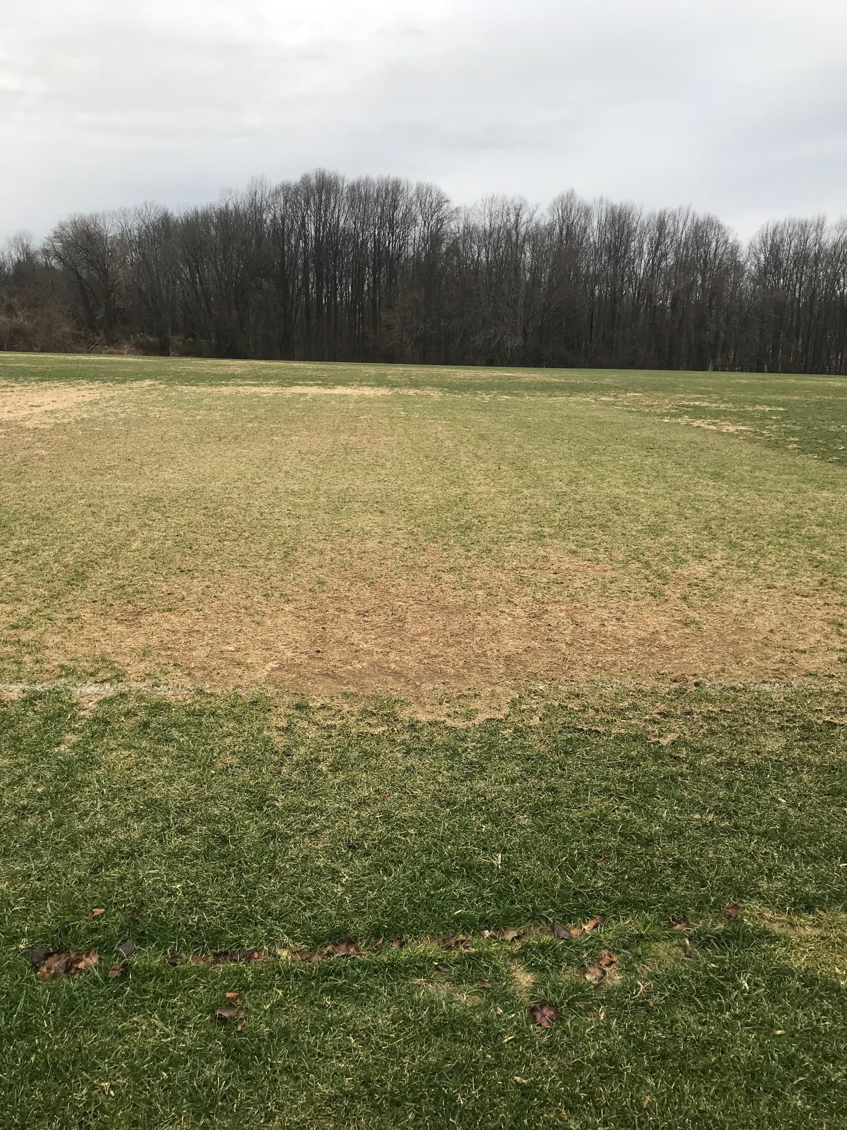
Agronomic Plan Benefits
Ground work for establishing a standard for turfgrass management
Organizing and budgeting each step in the process
Providing a uniform and consistent playing surface throughout the season
Fallston Recreation Center

Slide 4
Overseeding and Spot Seeding
Three different types of blends:
Seed Mix 1: Newsom Trio Mix (80% Tall Fescue, 10% Perennial Ryegrass, 10% Kentucky Bluegrass) $75.00 per 50 lb. bag
Seed Mix 2: Newsom Tall Fescue Blend (100% Tall Fescue) $69.00 per 50 lb. bag
Seed Mix 3: Newsom Premium Mix (90% Tall Fescue, 10% Perennial Ryegrass) $68.00 per 50 lb. bag

Slide 5
Overseeding Cost Analysis

Slide 6
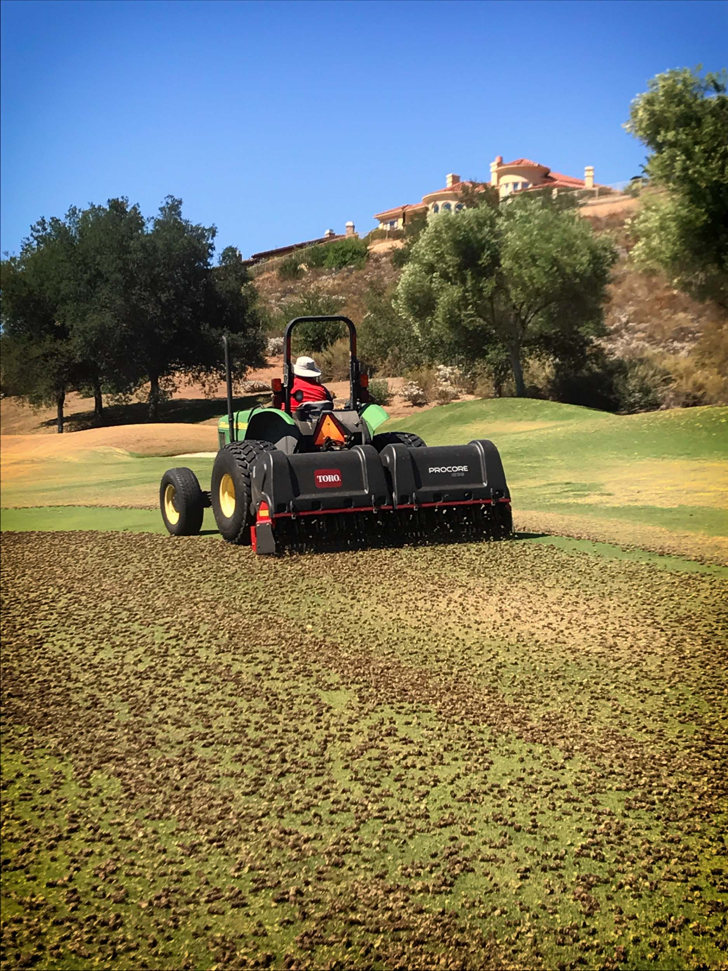
Aerification: Deep-tining, Verti-Quake
Compaction
Drainage
Air/gas exchange
Potential to be contracted out
Madera's Golf Club, 2017

Slide 7
Mowing Practices
Drop of mowing height
increased tillering
increased density
Routinely switch mowing directions
Drop in mowing height attainable?

Slide 8
Recommendations
Seeding
Seed Mix 1: Newsom Trio Mix (80% Tall Fescue, 10% Perennial Ryegrass, 10% Kentucky Bluegrass) $75.00 per 50 lb. bag
Mixed stand promotes less disease, less insects, less problems
Aerification
Deep-tining by way of rented tractor attachments, or contracted out
relieves soil compaction by fracturing the soil profile, allowing more oxygen for the roots as well as creating drainage channels
Mowing
Change the mowing height to 2 - 2.25 inches, with a twice weekly mowing schedule

Slide 9
Fertilization
Three major nutrients
Nitrogen
Growth Nutrient
Phosphorus
Root Nutrient
2011 Maryland Fertilizer Use Act
Potassium
Plant Hardiness Nutrient

Slide 10
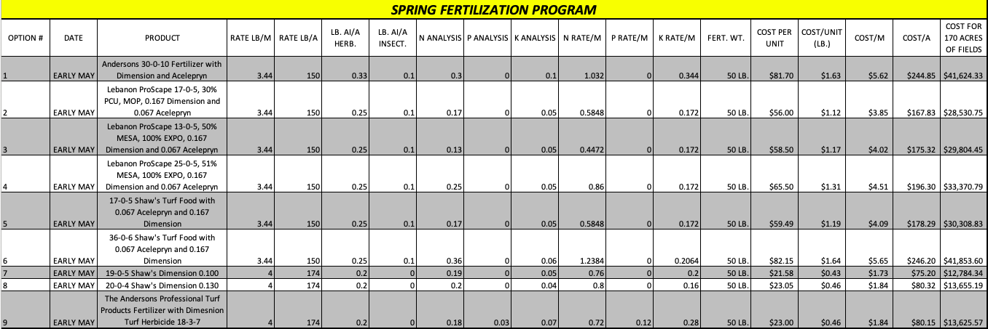
Fertilization Cost Analysis: Spring

Slide 11
Fertilization Cost Analysis: Fall

Slide 12
Basics of an Effective IPM Strategy
Most effective means with the least amount of input
Noxious weeds and invasive species can outcompete turfgrass
Establishing healthy turfgrass is the best start for IPM

Slide 13
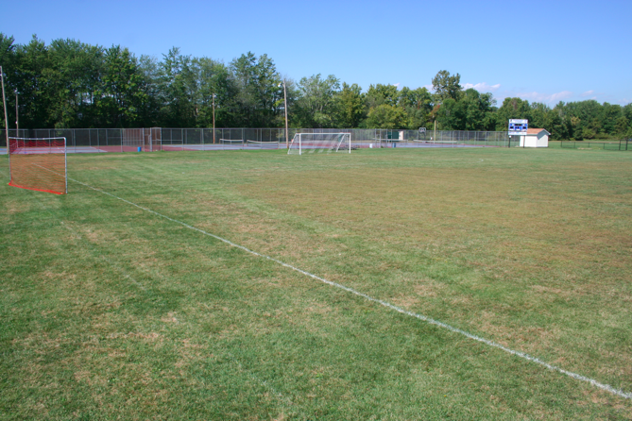
Weed Pressure
Crabgrass and Goosegrass are the two biggest pressures in the area
Too much competition!
Key is to stop them before they become a issue
Lampman, 2015

Slide 14
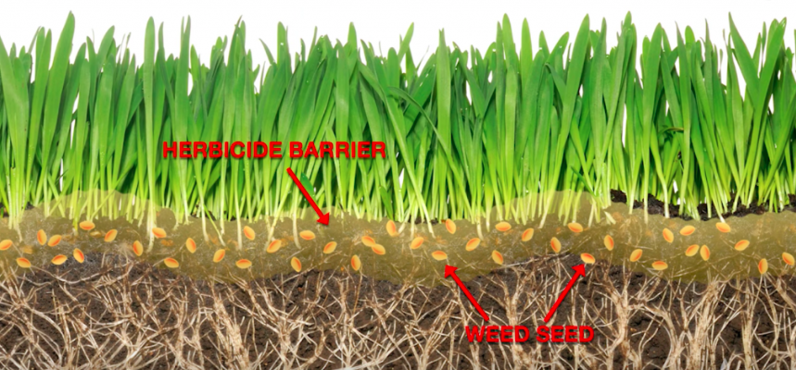
Stopping Weeds at the Source
Control: pre-emergent herbicide (Dimension)
Creates a barrier
Halts meristematic growth at the roots
Will not be able to grow past juvenile stage
Biczo, 2018

Slide 15
Fungicides: Where Do We Use Them?
Dollar spot and brown patch are the two key diseases and can be managed through a strong fertility program
Turf that has not previously been treated should not be treated
As with humans and medicine, turfgrass will develop a dependency
Prices outweigh practicality

Slide 16
Fungal Endophytes of Turfgrass
Certain endophytes have a symbiotic relationship with turf
Ward off surface feeding insects such as sod webworms and chinch bugs
Does not do anything for root feeding insects
TURFGRASS SPECIES
Tall fescue
Ryegrass
Fine fescue

Slide 17
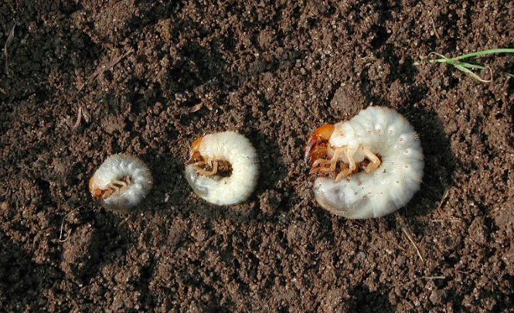
Grub Control
Grubs are the larval form of beetles
Feed on the roots
Control: Acelepryn
Main, 2005

Slide 18
Conclusion
In the creation of this plan we took into account
Budget limitations
Time constraints
Practicality
We’ve worked to create the most cost efficient, most effective plan
By following each step, the end product will be a denser, safer playing surface

Slide 19
Questions?
Envorinmental Turf Management 2016

Slide 20
References
Biczo, V. (2018, Feb 1). Early Turf Protection From Summer Weeds. Retrieved from ewing Irrigation and Landscape Supply: https://www.ewingirrigation.com/news/blog/early-turf-protection-from-summer-weeds/
Environmental Turf Management. (2016). pecializing In Sports Fields, Commercial And High End Residential Turf Installations With Sustainable Nutrition Management. Retrieved from Environmental Turf Management: http://etmturf.com
Lampman, J. (2015, Sep 24). The ABCs of School and Childcare Pest Management. Retrieved from Cornell Blogs: https://blogs.cornell.edu/schoolchildcareipm/2015/09/24/what-now-autumn-sports-field-management/
Madera's Golf Club. (2017, Jul 11). Summer Maintenance – Fairway Aerification. Retrieved from Medera's Golf: https://blog.maderasgolf.com/2017/07/11/summer-maintenance-fairway-aerification/
Main. (2005). Got Pests. Retrieved from Main: https://www.maine.gov/dacf/php/gotpests/bugs/grubs.htm

