Slide 1
FTA/MTA Purple Line TOD Grant:
Economic Development
April 19, 2021
Engagement Meeting Round 1
1pm-3pm National Center for Smart Growth
University of Maryland, College Park

Slide 2
Introductions
NCSG
Gerrit Knaap, Executive Director
Nick Finio, Associate Director
ECONorthwest
Becky Hewitt, Project Manager
Consultants
Terry Moore, Good Next Steps
Steve Brigham, Public Engagement Associates
In the chat, please state your:
Name
Agency/Organization

Slide 3
Overview: PLCC, FTA, MTA, TOD Planning Grant
Timeline
Summer 2020 - July 2022
Work products
Formalize/Expand Multi-stakeholder Collaborative for Coordination, Engagement and Monitoring
Corridor–Wide Multi-Mobility and TOD Assessment
Economic Development Assessment and Business Preservation Strategy
TOD Finance and Implementation Recommendations

Slide 4
Structure of this study element
Conditions
Past and Current
Drivers; Opportunities & Constraints
Trends
Trend Changers
We are here
Future Conditions
Possible, Likely, Desired
The Economic Assessment
Refinement of Desired
Goals & Values
Outcomes
Recommended
Options: Policies, Programs, Investments
We end here
Actions
Continuing work by PLCC & Others
Choices, Implementation

Slide 5
High-level Goals for the Project
Goals of the economic development assessment and recommendations:
Capitalize on opportunities for inclusive economic development offered by the Purple Line
Improve access to jobs and essential needs & services equitably
Support economic development goals and corridor revitalization, while minimizing negative impacts of gentrification
Notes:
This is basically stealing language from the original work plan.

Slide 6
Meeting Agenda & Goals
Agenda
Introductions and Overview (done)
Framework, Goals & Areas of Focus (5 mins)
County / Regional Context (10 mins)
Corridor Conditions & Projection (10 mins)
Transit Impacts on Economic Development (5 mins)
Q&A (10 mins)
Breakout Groups (30 mins)
Report Outs (15 mins)
Next steps (5 minutes)
Goals
Refine understanding of local economic context
Highlight Purple Line opportunities and threats for inclusive Economic Development
Identify potential interventions

Slide 7
Framework, Shared Goals & Existing Initiatives
Becky Hewitt, ECONorthwest
If you have questions, please type them into the chat. We will address them during the Q&A period.

Slide 8
Defining Inclusive Economic Development
Economic development is the process of improving a community’s well-being through job creation, business growth, and income growth as well as through improvements to the wider social and natural environment that strengthen the economy
-American Planning Association
Inclusive economic development prioritizes shared prosperity, promotes economic opportunity and mobility for historically marginalized groups, and counteracts economic disparities based on race and other markers of social identity
Notes:
For our work, we are taking a broad view of economic development that encompasses job creation, business growth, and income growth, but also other social and environmental improvements that benefit the economy and community well-being. We are particularly focusing on how those benefits can be broadly shared, and improve conditions for marginalized groups.

Slide 9
Overview of Goals & Initiatives
Many organizations, many shared goals
Focus on 3 topics:
Workforce Development
Small Business & Entrepreneurship
Key Industries
Land use, transportation addressed in other forums
Notes:
It’s clear from who’s in the ”room” today that there are many organizations with interests and expertise in this space. While you each have a different focus, there are a number of shared goals. We are focusing on how the purple line and potential TOD could affect three core topics that touch on several of those goals: workforce, small business, and key industries. While transportation and land use are at the heart of this project are clearly tied into this topic, specific opportunities related to land use and transportation are being addressed in other forums, including meetings last week and next week.
I’m going to briefly summarize what we’ve seen in looking at many of your goal statements and existing programs. If you notice something missing from that summary (or the more detailed version in the background document) that feels important, please feel free to type it in the chat and we’ll capture those updates.

Slide 10
Workforce Development Goals
PLCC: “build a thriving labor market”
individuals in the corridor can compete for higher-quality/higher-skill jobs
employers in the corridor can compete more effectively within the regional marketplace
Related objectives:
pathways to sustainable wage jobs
supporting the needs of businesses and targeted industries by connecting them with a qualified workforce
Notes:
Related to workforce development, the PLCC has articulated a goal to improve the ability of corridor residents to obtain quality jobs and of corridor employers to attract employees. Several of your organizations share missions around building pathways to sustainable wage jobs and helping connect businesses with the workforce they need to grow and thrive.

Slide 11
Workforce Development Initiatives
WorkSource Montgomery and Employ Prince George’s, Inc. occupational training
Community College credit-based career and technical education (CTE) and non-credit continuing education programs
Targeted programs for certain groups (e.g., 55+, immigrants, individuals with disabilities or barriers to employment)
See something we missed? Type it in the chat and we’ll make sure it’s captured.
Notes:
There are many existing workforce programs, and we have a more specific list in the background document, but there are County-level programs for occupational training, community college programs, and a variety of organizations serving specific groups that may otherwise face greater obstacles to employment.

Slide 12
Small Business & Entrepreneurship Goals
PLCC: support and grow local businesses
Focus on micro-businesses in equity areas
Related objectives:
business attraction, retention and expansion
fostering entrepreneurship & innovation to support a diverse and competitive economy
PLCC Equity Areas:
Greater Riverdale
Northern Gateway/Langley Park/Hyattsville
Takoma/Langley Crossroads
Long Branch
Bonifant Street/Fenton Village in Silver Spring
Brookville Road Business District
Notes:
The PLCC is also prioritizing supporting and growing very small local businesses in the corridor, particularly within the 6 equity areas listed on the right. The focus so far has been on the immediate challenges facing these businesses due to COVID and construction so that as many of the existing small businesses as possible survive those disruptions.
Many of you have goals related to helping support existing businesses, and fostering entrepreneurship and innovation

Slide 13
Small Business & Entrepreneurship Initiatives
Countywide programs
Montgomery County Economic Development Corporation & Prince George’s County Economic Development Corporation business assistance & Business Incubator programs
Montgomery County Small Business Assistance and Microloan Programs
Prince George’s Small Business Growth Fund and Microenterprise Loan Fund
Community College programs
Montgomery College’s Small Business, Entrepreneurship & Licensure Programs
Innovation Hub at Prince George’s Community College
Other organizations
Small Business Development Centers
Latino Economic Development Center (LEDC) & others
Chambers of Commerce
Existing corridor-specific efforts
PLCC’s Small Business Action Team: COVID recovery, construction disruptions
LEDC loans for small business preservation and new entrepreneurs with additional funding from JP Morgan Chase’s Partnership for Raising Opportunity in Neighborhoods
$2.5 million state allocation for small businesses in the Purple Line Corridor (passed in 2021 session)
See something we missed? Type it in the chat and we’ll make sure it’s captured.
Notes:
As with workforce, there are many existing programs intended to support small businesses and/or entrepreneurship. I won’t attempt to read them all, but I will note that because of the immediate concerns for small businesses in the corridor, there are already corridor-specific small-business preservation efforts funded and underway.

Slide 14
Key Industries Goals
Prince George’s County key industry clusters:
Federal Government
Business Services
Health Care and Life Sciences
Information, Communication and Electronics industries
Montgomery County’s economic drivers/target markets:
Bio health/Biosciences
Information Technology and Cybersecurity
Financial Services
Advanced Manufacturing
Corporate/Regional HQ
Entrepreneurs and Innovators
Notes:
Both counties identified several key industry clusters or targeted segments for growth in their most recent Economic Development Strategies, though both are at least 5 years old now. Both place an emphasis on knowledge-based industries.

Slide 15
Key Industries Initiatives
Prince George’s County
High Technology Facilities Tax Credit
Economic Development Incentive Fund
New Jobs Tax Credits
Montgomery County
Economic Development Fund Grant & Loan Program
SBIR/STTR Matching Grant Program
Biotechnology Investor Incentive Program
See something we missed? Type it in the chat and we’ll make sure it’s captured.
Notes:
Both counties also have existing incentive programs to attract employers and investment in the targeted industries.

Slide 16
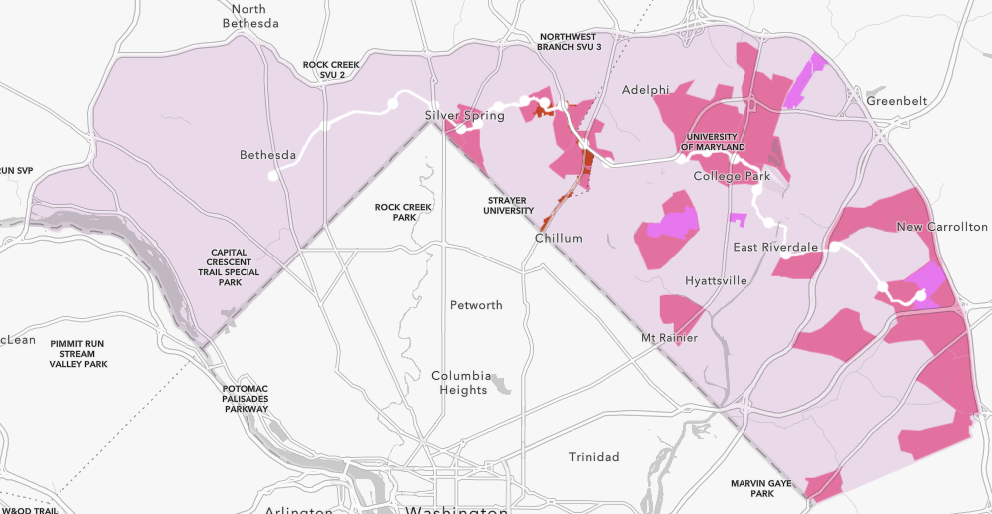
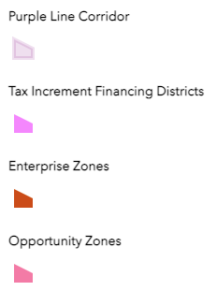
Other economic development incentives
Notes:
Both counties also have other incentives available within the purple line area, including TIF districts, a few enterprise zones, and opportunity zones.

Slide 17
County / Regional Context
Terry Moore, Good Next Steps
If you have questions, please type them into the chat. We will address them during the Q&A period.

Slide 18
National Context: 70 years of US GDP
• Last 10 years: long period of stability, but modest growth
• COVID-induced crash and recovery
https://fred.stlouisfed.org/series/GDP
Grey bars = recessions
Notes:
This slide illustrates the recessions

Slide 19
This region in the national context
Near the top of the pack on many indicators of economic activity
Amount and density
Diversity → more stability
Growth in high-value sectors
But always room for improvement
Strong regional economy in weakened national economy
Lower marks on distribution of benefits
Notes:
The Washington, D.C., region scores high on all kinds of typical and less-typical measures of economic strength. Numbers abound to support claims that the economy of Washington, D.C., is (1) big (lots of people, lots of jobs), (2) diverse (lots of different types of business, occupations, and opportunities), and (3) dense (lots of jobs in a relatively small area, with relatively good accessibility: people can get to a lot of jobs in what they consider an acceptable commuting time). A regional economy may be specialized (high concentrations of economic activity in a few key business sectors) or diversified. Public policies to encourage diversification are more conservative, and similar to those recommended by financial advisors to individuals and pension fund managers: reduce risk by investing in different sectors in different locations, and by giving up some of the heady gains of a booming stock market for the more stable stream of revenue from bonds.
That position at the top, however, does not insulate a regional economy from setbacks, nor does it mean that all locations and groups in a booming regional economy share in the boom. Thus, even in a good economy there is room for improvement.
E.g.
The Impact of COVID-19 on US Firms Nicholas Bloom, Robert S. Fletcher, and Ethan Yeh NBER Working Paper No. 28314 January 2021 JEL No. E0,J0,L0
ABSTRACT
We use survey data on an opt-in panel of around 2,500 US small businesses to assess the impact of COVID-19. We find a significant negative sales impact that peaked in Quarter 2 of 2020, with an average loss of 29% in sales. The large negative impact masks significant heterogeneity, with over 40% of firms reporting zero or a positive impact, while almost a quarter report losses of more than 50%. These impacts also appear to be persistent, with firms reporting the largest sales drops in mid-2020 still forecasting large sales losses a year later in mid-2021. In terms of business types, we find that the smallest offline firms experienced sales drops of over 40% compared to less than 10% for the largest online firms. Finally, in terms of owners, we find female and black owners reported significantly larger drops in sales. Owners with a humanities degree also experienced far larger losses, while those with a STEM degree saw the least impa

Slide 20
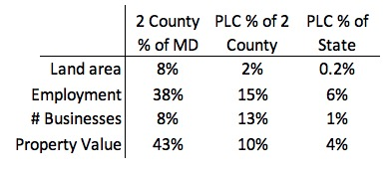
This region at the county level
Concentration of economic activity
Small amount of land, large amount of activity
Notes:
Many of you in the room know the data and issues better than we do. But a high-level summary is:
I’ve asked Nick if he can get me some data here to help me finish this thought:
“It is typical to talk about a regional economy by talking about a county or group of counties. Sometimes that works well enough, but often the bulk of the economic activity is concentrated in a small portion of a county. For this study, what we have defined as the PLC works well as way of illustrating the concentration of the Montgomery and Prince G’s counties’ economic activity around the capital district. “
Then I’d like just a few number on PLC as a % of County for each County. Easy metrics, I hope, would be:
Land area
Population
Then any measures of economic activity you might have easily available:
Total employment
Number of businesses
Number of large (?) businesses
total annual Income
Property value
?
Just got this response (8:40 AM on Tues)
Hi Terry,
We can get you these data. I have copied my colleague Hyunjoo who can help with some of the computations. Hyunjoo, Terry formerly worked with Becky at ECONW, and he is doing some of the economic development work for the FTA grant. He needs these answers for a presentation next monday.
Some of the figures might involve a bit more computation in GIS than others, so it may take a day or two to get back to you with the answers. Hyunjoo, this can take priority over anything else you are currently working on.
Land area - Hyunjoo, please divide the total land area in the PL corridor (5 subareas) / total land area in the counties. Calculate for each county, and the two counties combined.
Population - This one I can answer off-hand. We have a total PL area estimated population of 173,441 (2019 census estimate). Moco population is 1.05 million, prince george's is about 910k. Moco PL population is about 95k; prince george's about 78k. Therefore the PL is about 8.8% of the bi-county population; 9% of Montgomery's population, and 8.5% of Prince George's.
Then any measures of economic activity you might have easily available:
Total employment - This is a rough guess, which we will update, because it's comparing one survey (QCEW, which measures employment at establishments for corridor level) versus BLS current population survey (county, which is a survey of residents based on where they live and asks whether or not they are employed). PL total employment from QCEW = 150k (100k MC, 50k PG). Montgomery total employment = 500k; Prince George's total employment = 450k, both from BLS CPS. Therefore the corridor is about 15% of total employment in the counties. It's about 30% of total employment in Montgomery, but only 11% in Prince George's. Hyunjoo can you crosscheck purple line employment (total and in each county) with total employment in both counties from the QCEW data? You can use 2020Q1 to pick up pre-pandemic trends. That would be more accurate.
Number of businesses. Hyunjoo, can you get these numbers from QCEW 2020Q1? Total # of businesses in each county, total # of businesses in the corridor, total # of businesses on each side of the corridor.
Number of large (?) businesses. We can get this from QCEW. Hyunjoo, please count the number of businesses with 50 or more employees, for the same geographies as the above bullet point.
total annual Income - I don't think we have a reliable estimate for this. We could calculate total wages paid from the QCEW data in the corridor versus outside the corridor. Hyunjoo can you try that for the same geographies as above?
Property value - Hyunjoo, you can do this with the parcel datasets. Compute the sum of total parcel value (land + improvement) for each county. Then compute it for each half of the corridor.
I'll add:
Unemployment rates: for 2018, the rate was 4.1% in PGC and 3.2% in MC. Compare those rates against the full corridor rate (5.29%)

Slide 21
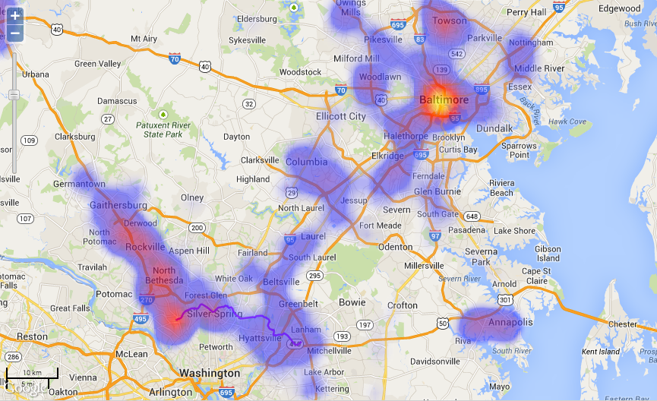
Employment Concentrations in MD

Slide 22
Purple Line Employment Cluster
Purple Line stitches together 4 of Maryland’s 15 biggest
employment cluster to create Maryland’s biggest cluster

Slide 24
County Context
Prince George’s County
Montgomery County
Demographics (2015-2019 ACS)
62% Black or African American, 18% Hispanic, 13% White
33% residents w/ bachelor’s or higher
Median income: $84,920
Business Ownership: 77% minority and 45% women (2012 Survey of Business Owners)
Unemployment Dec 2020: 8.0%
Demographics (2015-2019 ACS)
44% White, 20% Hispanic, 18% Black or African American, 15% Asian
60% residents w/ bachelor’s or higher
Median income: $108,820
Business Ownership: 43% minority and 39% women (2012 Survey of Business Owners)
Unemployment Dec 2020: 5.7%

Slide 25
County Context – Target Industries
Prince George’s County
Montgomery County
Federal Government
Business Services
Health Care and Life Sciences
Information, Communication, and Electronics
Bio health/Biosciences
Information Technology and Cybersecurity
Financial Services
Advanced Manufacturing
Corporate/Regional HQ
Entrepreneurs and Innovators
Becky You have this same slide in your presentation above. I think we just delete it here

Slide 26
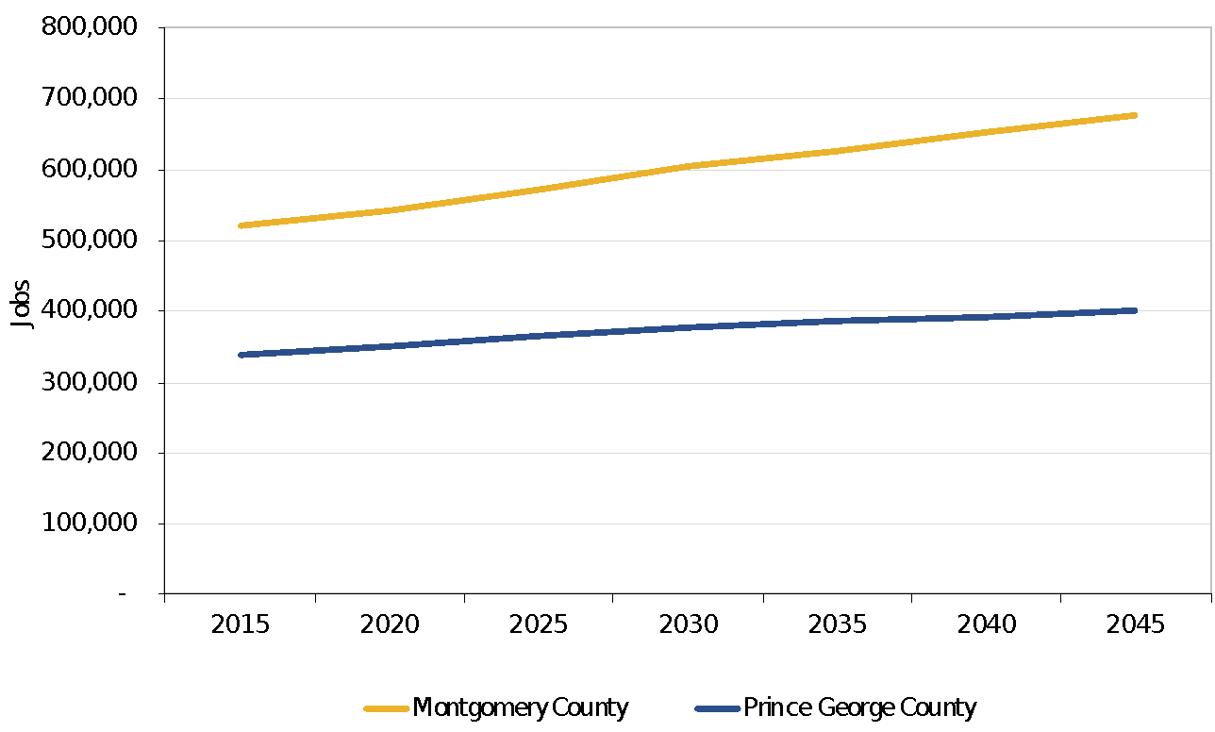
County Employment Projections
Faster employment growth projected in Montgomery County
Projected increase in employment, 2015 – 2045: Montgomery County: 30% Prince George’s County: 19%

Slide 27
COVID-19 Impacts in the region
2020 decrease in regional employment: 177,800 jobs (5.2% of total)
Leisure and Hospitality (-25%)
Education and Health Services (-7%).
Statewide employment is not expected to regain its prior peak until mid-2022
Minorities, low-income and women have disproportionate decreases

Slide 28
Corridor Conditions & Projection
Nick Finio, NCSG
If you have questions, please type them into the chat. We will address them during the Q&A period.

Slide 29
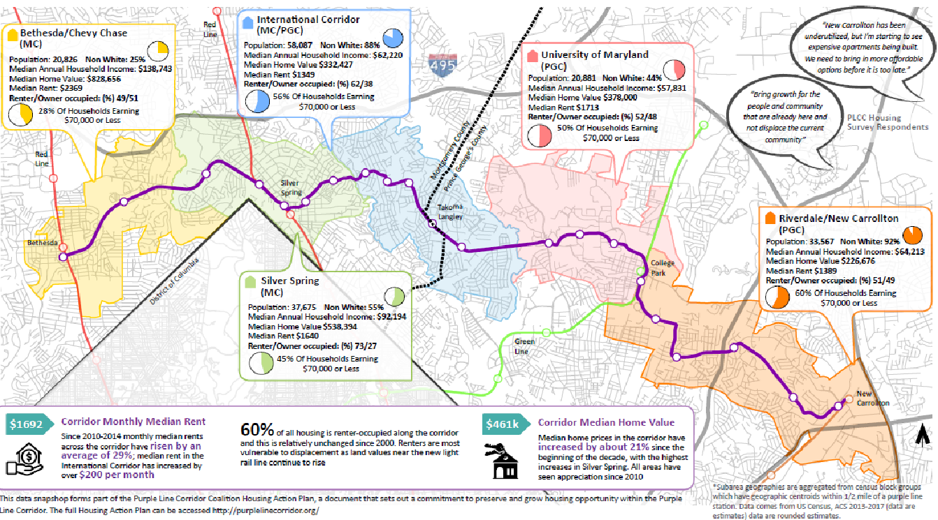
Corridor Conditions

Slide 30
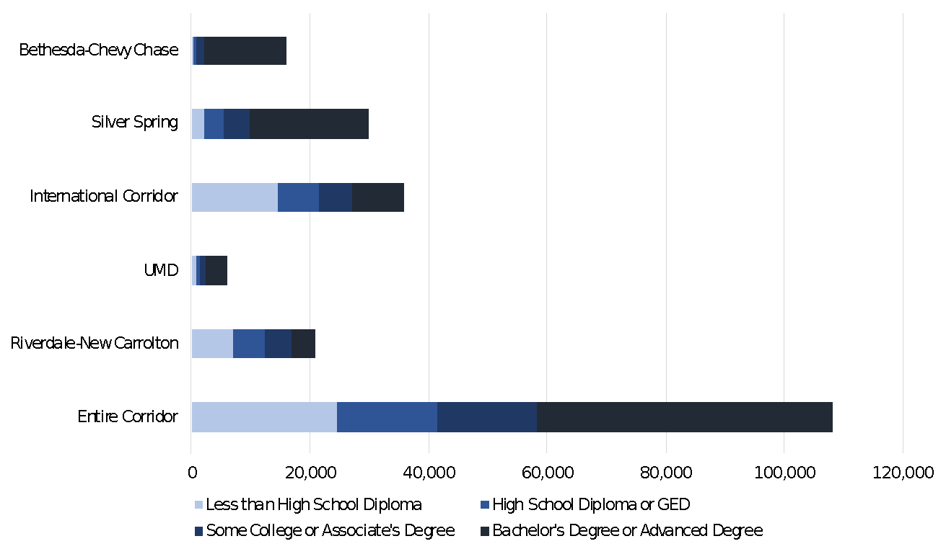
Educational Attainment
Source: 2015-2019 Census ACS 5-year estimates

Slide 31
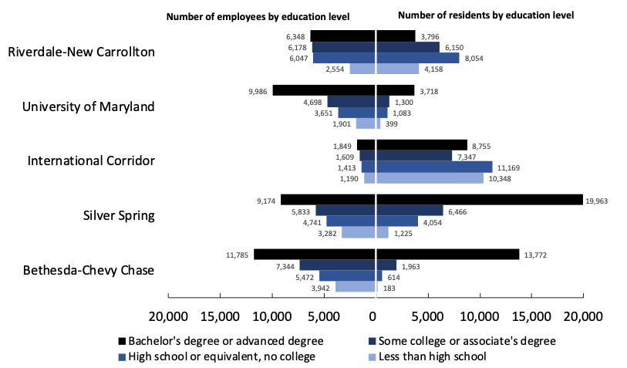
Jobs-Worker Balance by Subarea
Source: 2015-2019 Census ACS 5-year estimates and 2019 LEHD

Slide 32
Employment by Wage
Source: 2019 LEHD

Slide 33
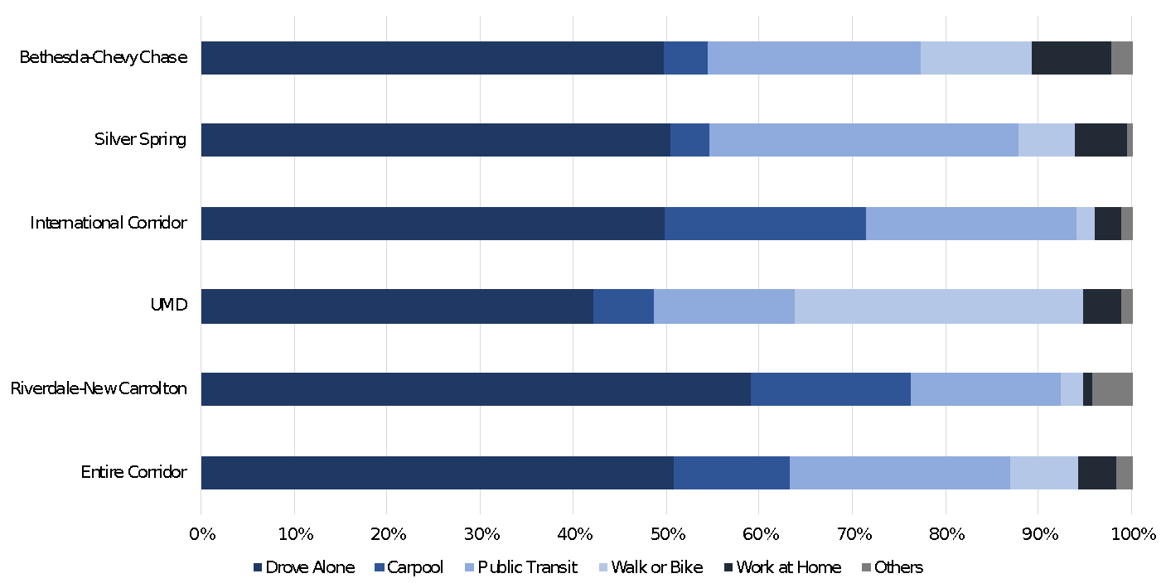
Mode of Transportation to Work
Workers Ages 16 and Over (pre-pandemic data)
Source: 2015-2019 Census ACS 5-year estimates

Slide 34
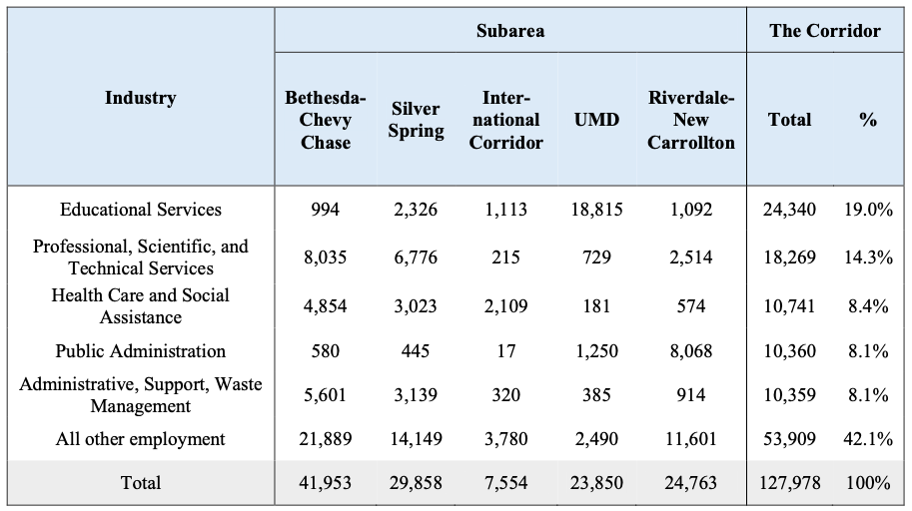
Employment by Industry & Subarea (2013)
The employment data in this table has not been updated, since the distribution of employment as of 2013 formed the basis for the employment projections that follow.

Slide 35
Corridor Employment Projections
Methods for 2017 NCSG projections:
Economic model (“TREDIS”) estimates regional impacts in terms of changes in costs, productivity, employment, and economic growth
Allocated county-level employment growth proportionately to the corridor based on the job distribution and industry base in the Purple Line
Compared “build” and “no-build” scenarios to model impacts of Purple Line construction & operation

Slide 36
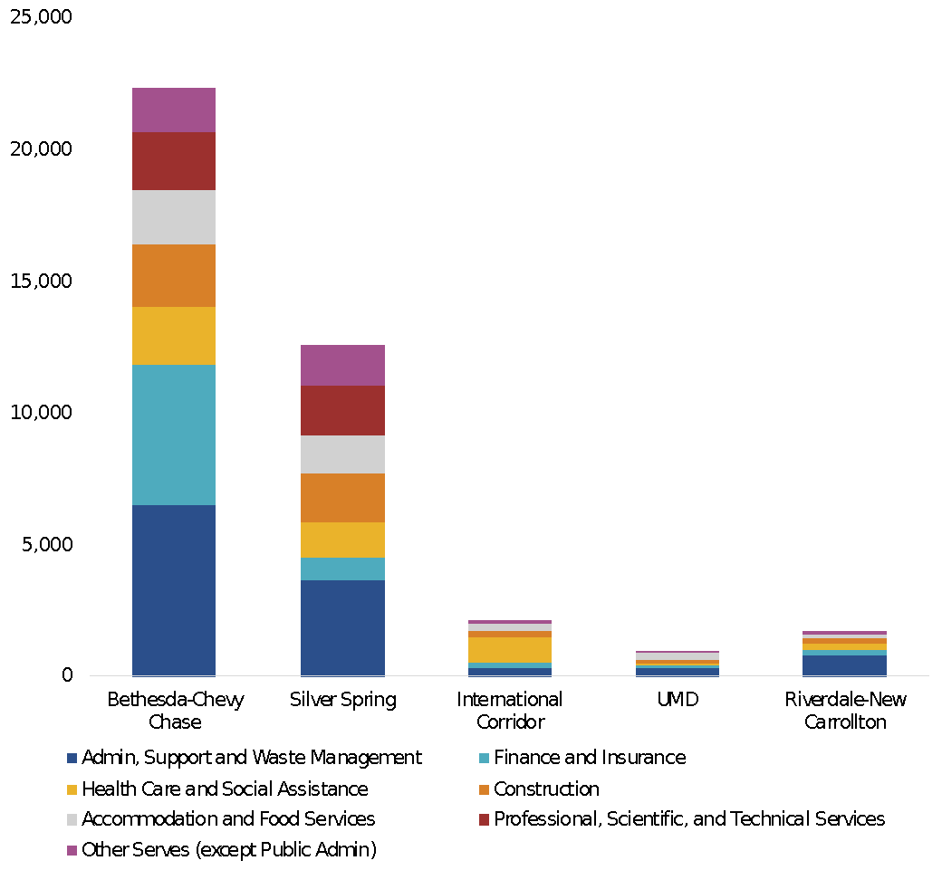
Corridor Employment Projection
Projected Growth in Jobs by Industry, Build Scenario 2016-2040
Job growth projected to be especially strong in:
construction
finance and insurance
professional and technical services
administrative support
health care
Notes:
Add a slide to talk about
Job Growth by Geography
Bethesda-Chevy Chase - 25,000 jobs
Silver Spring - over 14,000 jobs
the International Corridor - less than 2,500 jobs
the University of Maryland - less than 1,000
Riverdale-New Carrollton - less than 1,000

Slide 37
Linking Transit, TOD, and Economic Development
Becky Hewitt, ECONorthwest
Nick Finio, NCSG
If you have questions, please type them into the chat. We will address them during the Q&A period.

Slide 38
Transit Impacts on Economic Development
Literature shows transit can:
Increase the economic advantages of concentration, especially for certain industries.
Knowledge, office, arts-entertainment-recreation, retail-lodging-food service, education and healthcare
Change where firms locate and expand within a region.
Create both benefits and risks for low-income workers & small businesses.
Improved access to employment & services, reduced transportation costs
Increase in displacement risks
Disproportionate difficulties during construction for small businesses
Notes:
As Nick noted, their work did not fully account for all the ways that transit can impact the economy. We know that there are economic benefits when firms and people are clustered together and can more easily exchange goods, people, and ideas, and that transit can support higher population and employment densities and make it easier for people to move around. These effects particularly benefit knowledge-based industries, where the ease of getting people to and from work is a primary consideration (or at least it was, pre-COVID). Retailers, service providers, and hospitality services also benefit from greater visibility and accessibility due to transit. Education, healthcare, and government have also been shown to cluster near transit. Studies show that transit can shift where such businesses locate and expand within a region.
Transit can offer low-income workers better access to employment and services and reduced transportation costs, and small businesses can benefit from the increase in visibility and access. However, transit can also attract new people and businesses that may be able to pay more for housing or commercial space and can increase displacement risks.
NCSG has been working to analyze where the Purple Line will create the biggest improvements to access to employment and services. Nick is going to share a few relevant highlights from that work, which was presented in detail last week.

Slide 39
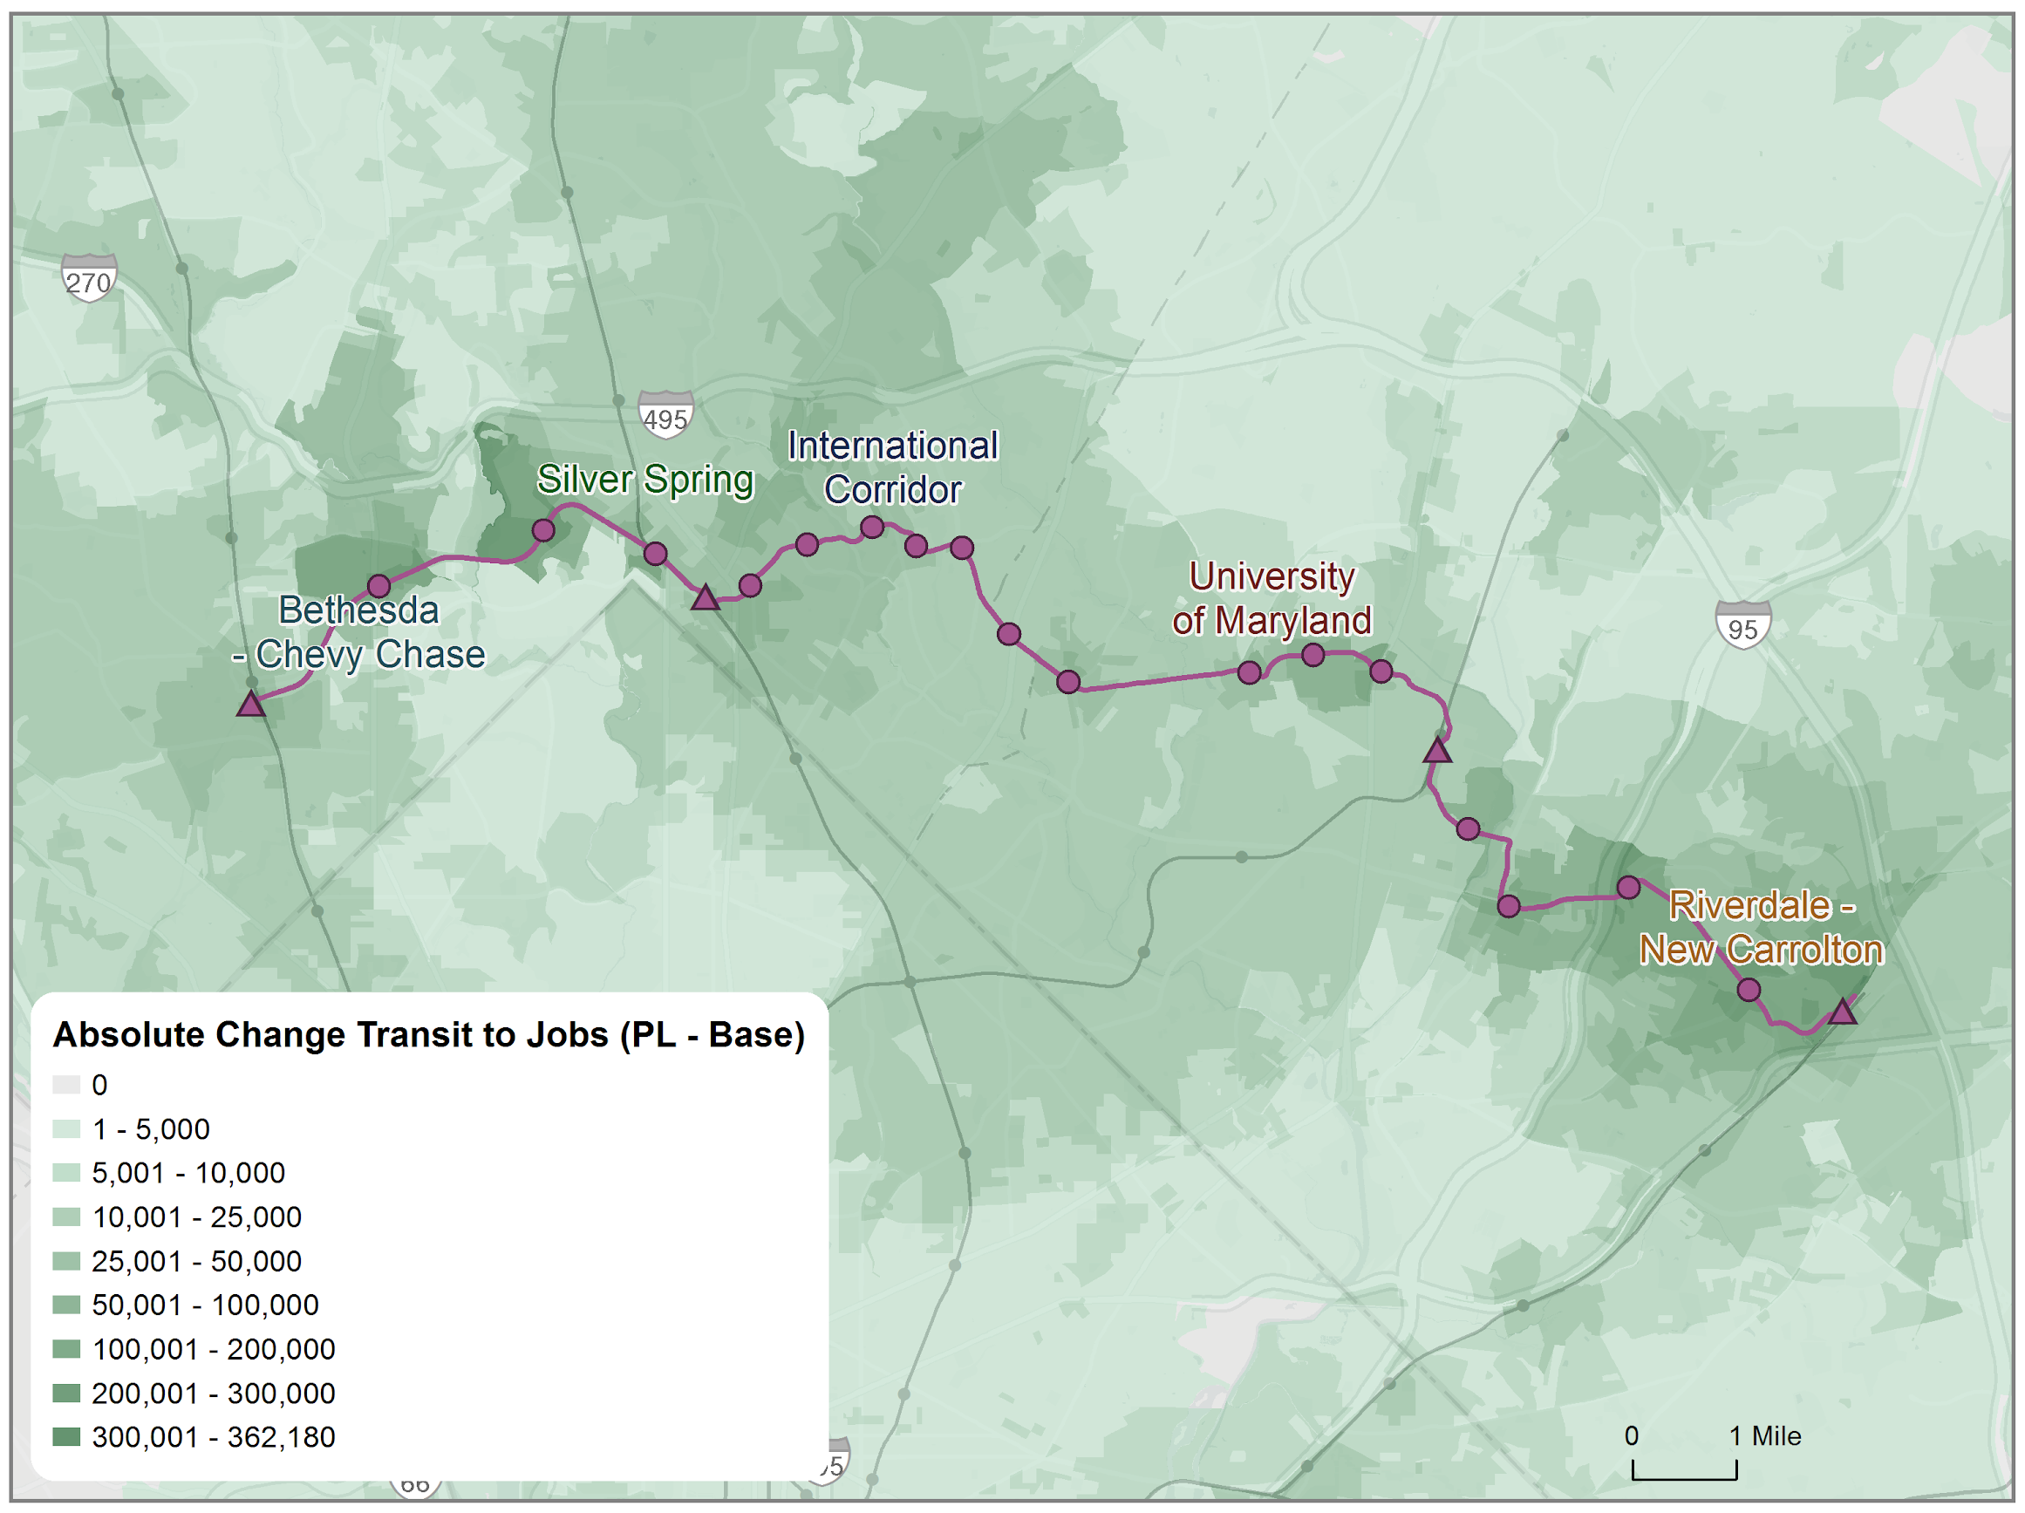
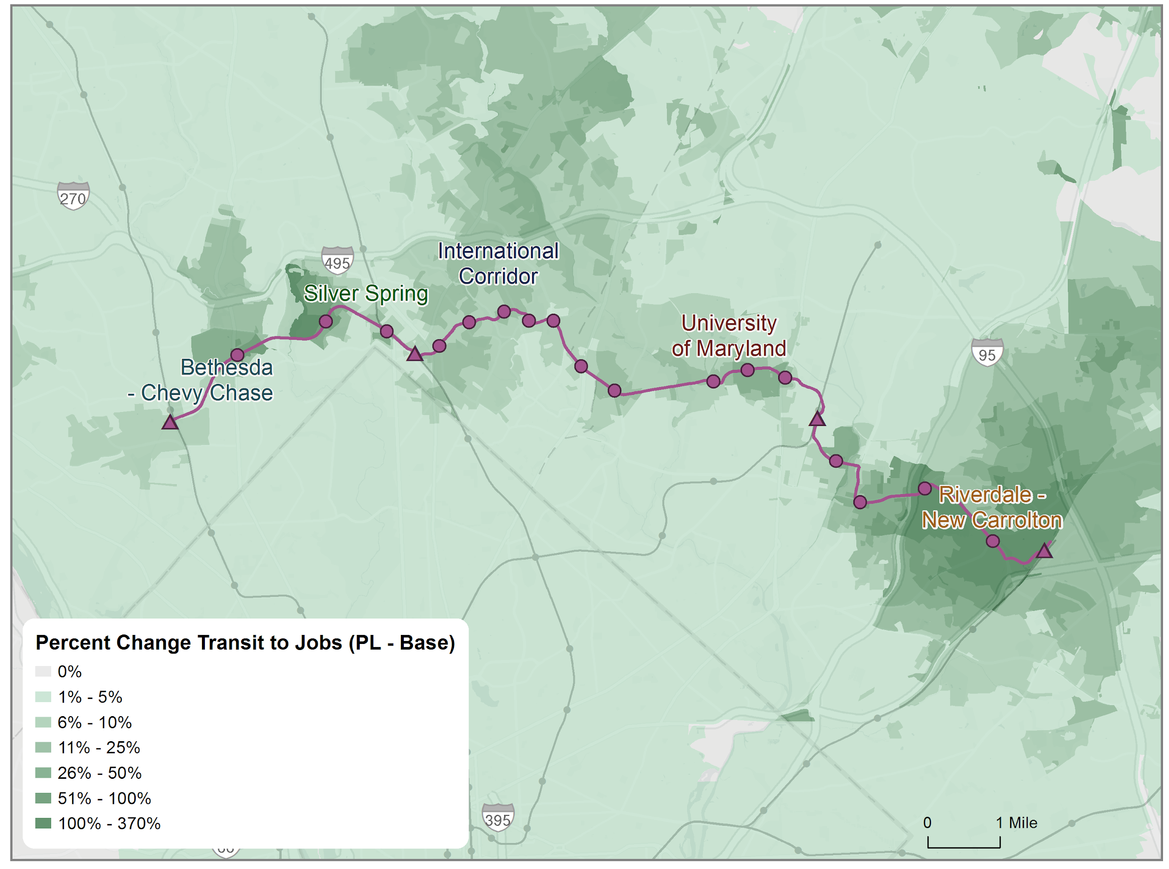
Where are the biggest improvements to job accessibility after the Purple Line begins service?
Level change in transit access to jobs (Purple Line - Baseline)
Percent change in transit access to jobs (Purple Line/Baseline)

Slide 40
Purple Line improves access to jobs for households in poverty

Slide 41
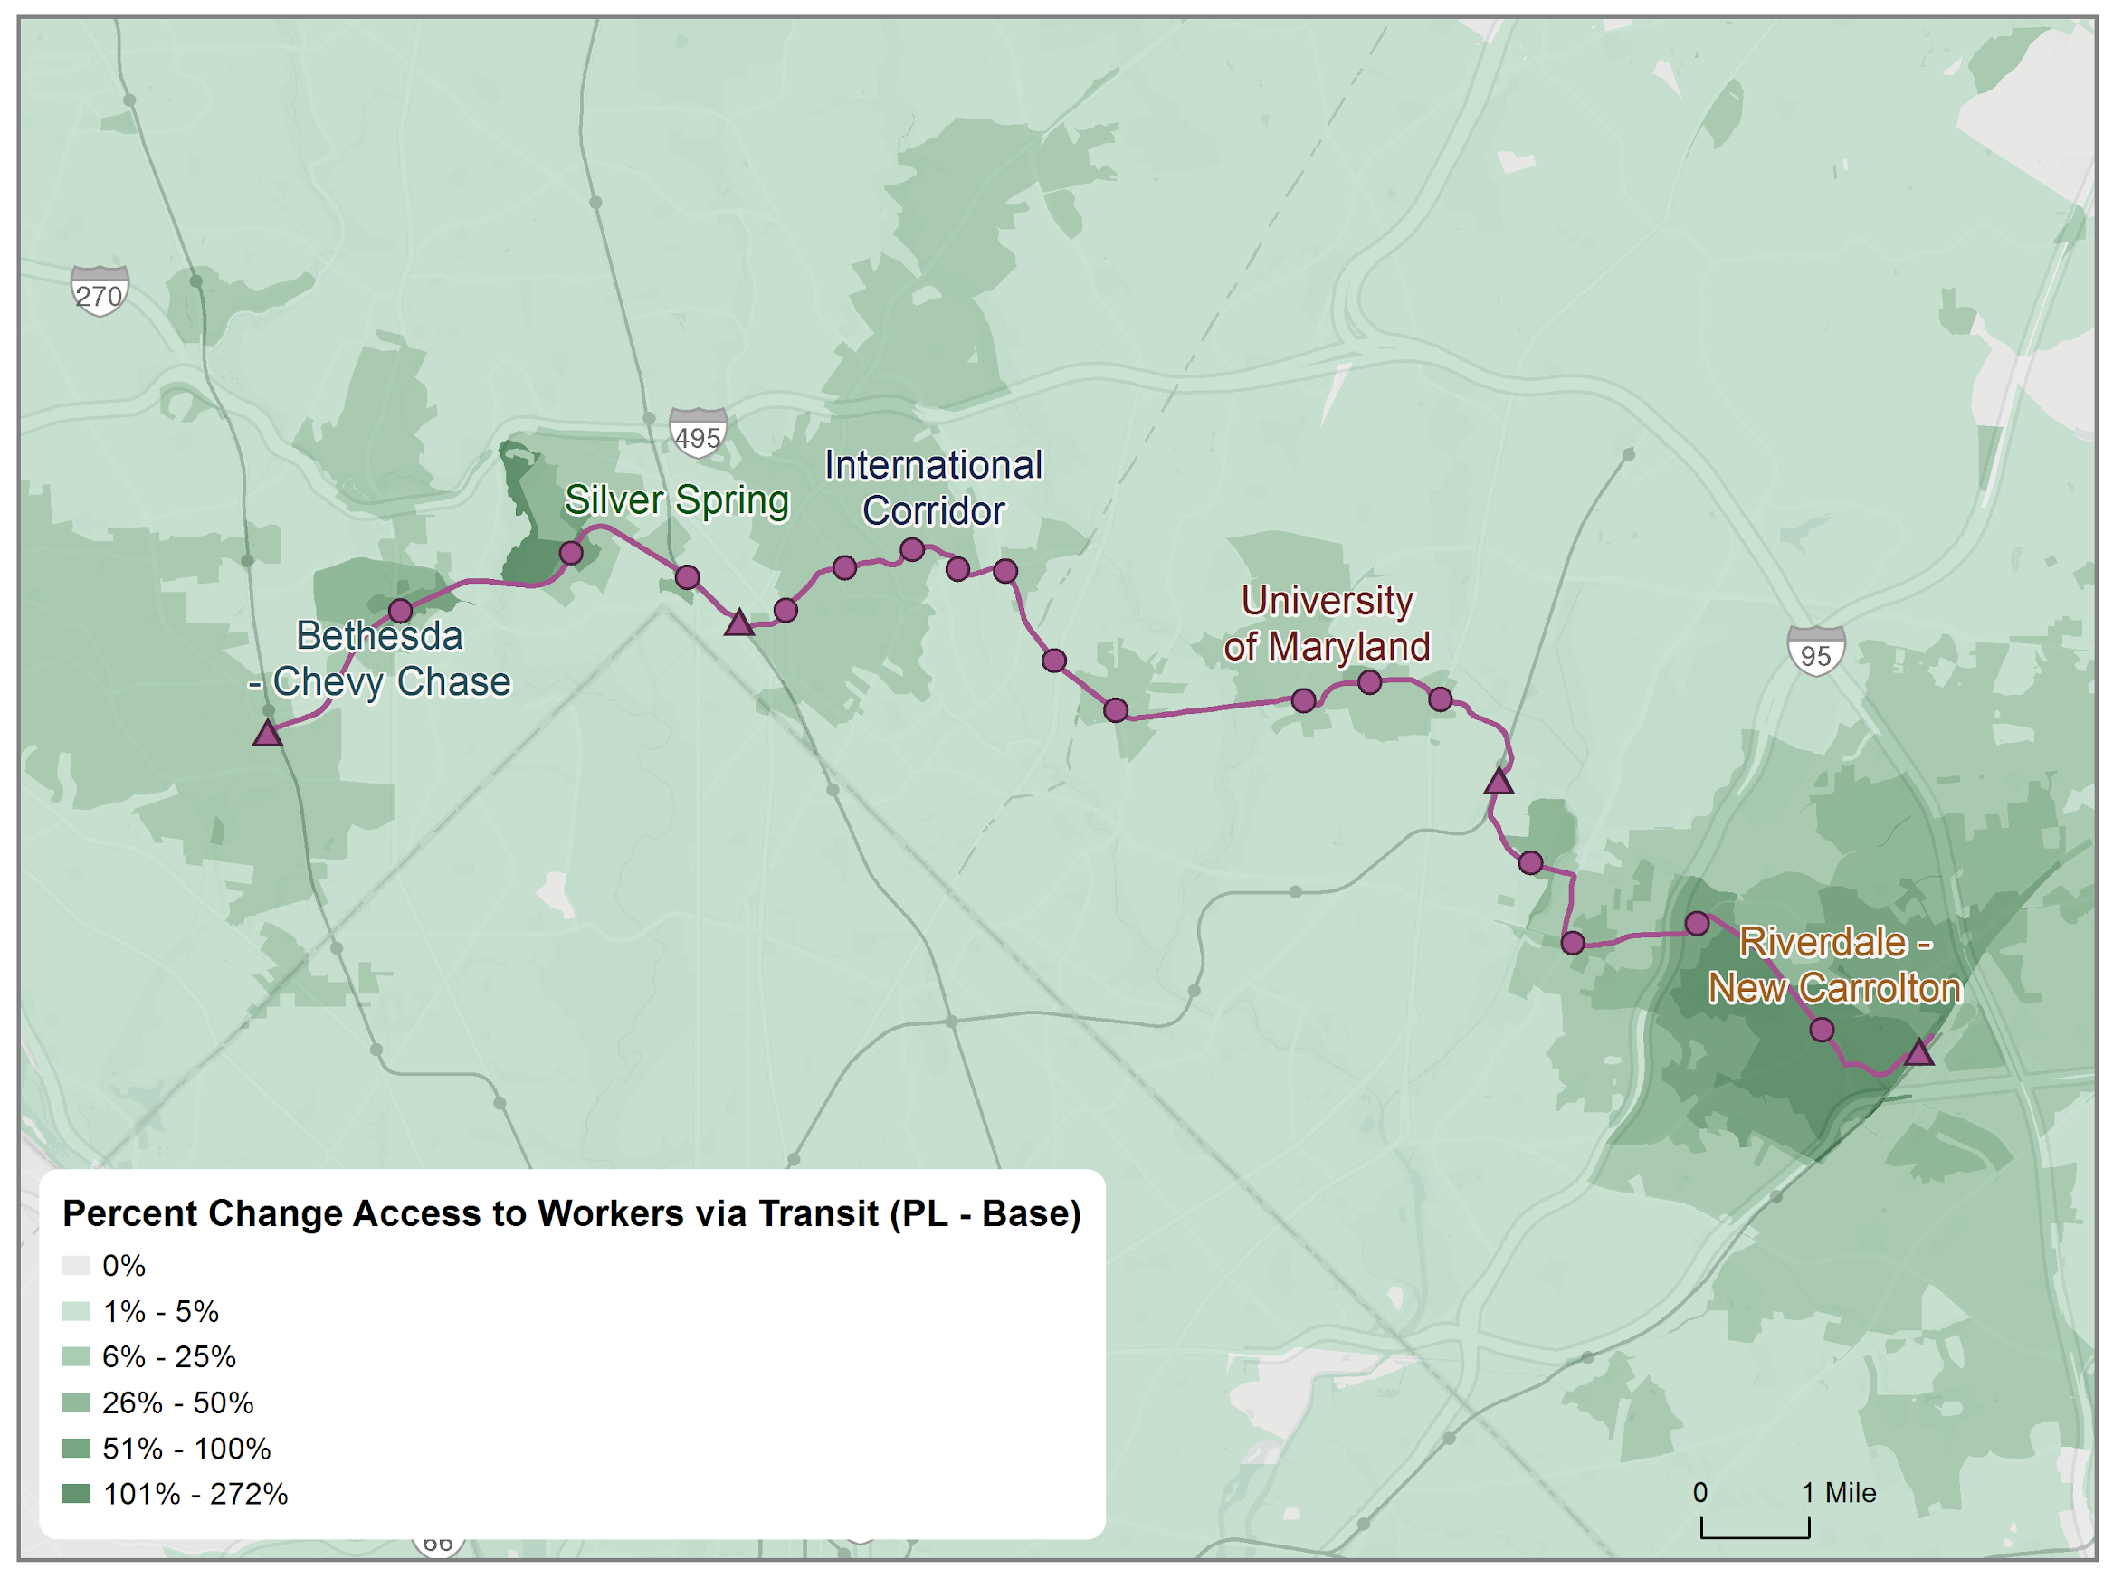
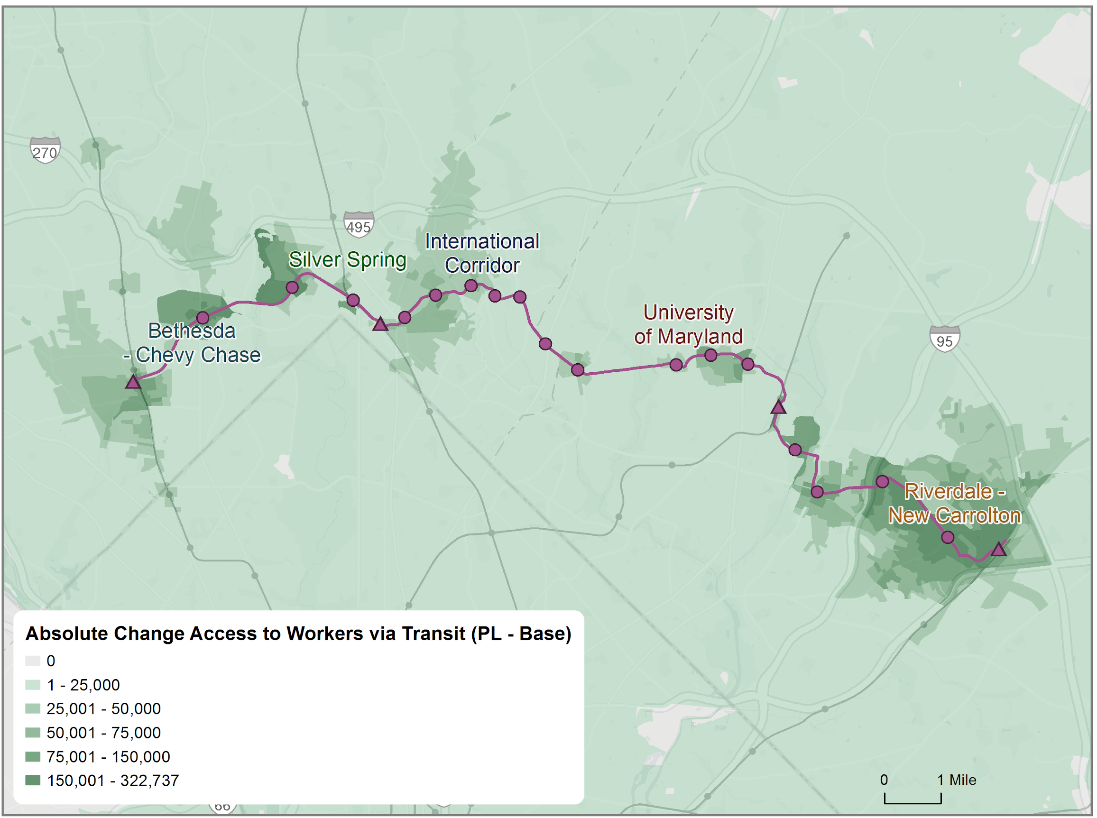
Purple Line improves access to workers

Slide 42
Linking TOD & Mobility Work
How will the Purple Line affect economic development and future economic conditions?
Purple Line increases accessibility between jobs & workers
Transit & new transit-oriented development could attract certain types of businesses and residents
Potential displacement risks
Notes:
So, we want to work with you all to understand how the Purple Line will affect economic development and future economic conditions in the corridor. As I noted before, there are separate land use and transportation assessments underway, but we want to begin to think about what the changes to transportation and land use, combined with the existing economic conditions and what we know of how transit generally affects economic development mean here.
We know that the purple line is going to connect major employment centers, it will increase accessibility between jobs and workers, and it will link places with a broad range of jobs to places with a broad range of residents, but that low-income residents may be at increased risk of displacement that would negate the benefits of transit for them.
We know that there are existing strong concentrations of key industries in the corridor, that many of these industries are likely to grow, and that many of them are likely to benefit from transit.
We know that the construction is contributing to small business disruptions, but that those that survive and can remain in the corridor could benefit from the greater levels of accessibility and visibility.

Slide 43
Q&A
Before breakout groups, let’s pause for overall Q&A about what you’ve all just heard.

Slide 44
Next: Breakout Groups
Workforce
Small Business & Entrepreneurship
Key Industries
Notes:
As we transition to the breakout groups, we encourage you to think about how, 5 to 10 years from now, you hope things will be in the purple line corridor, and what it would take to get there.
We’re going to have you choose a breakout room based on one of the three topics we talked about, but you’ll be considering similar questions

Slide 45
Breakout Session Questions
What have you heard that you think is important for this topic? Is there anything we missed?
What are the biggest opportunities that the Purple Line creates in the corridor for your topic? What are the threats?
What should be done to capitalize on the opportunities, and mitigate the threats?

Slide 46
Enter Breakout Groups
Please choose your breakout using the breakout button at the bottom of your zoom window:
Workforce - Steve Brigham [notetaker: Margaret]
Small Business & Entrepreneurship – Becky Hewitt [notetaker: Lily]
Key Industries – Terry Moore and Nick Finio [notetaker: Cyrus]

Slide 47
Report Outs
Workforce
Small Business & Entrepreneurship
Key Industries

Slide 48
Next Steps for you
Receive follow-up email and respond to survey
Check out our website where we will share materials
Reach out to us directly if you have info to share
Attend September meeting
Next Steps for us
Inform and evaluate TOD policy scenarios
Write up full economic development assessment
Draft recommendations
Next Meeting
Late September
Virtual or in person?
TBD!
Contact
nfinio@umd.edu

